Slide 1

GRCF Seminar Series
Featuring: ThermoFisher Scientific
Title: Optimization of a phenol red-free T cell expansion medium to improve performance and workflow flexibility
Presenters: Kimesha Hammett, Field Application Scientist

Slide 2
T Cell Therapies
Novel Tools for Cell and Gene Therapy Applications
Kimesha Hammett, Field Application Scientist
January 2020

Slide 3
Gene-Modified T Cell Manufacturing Workflow
Cell isolation
and activation
Cell engineering
Cell expansion
Wash, fill, finish,
and cryo
Lot release and characterization
Isolation/activation
beads and magnets
Lentiviral
production systems
Catalog and
custom media
Wash
Safety, identity, and
purity testing
Gibco™ CTS™ Dynabeads™ CD3/CD28 magnetic beads
Gibco™ CTS™ DynaMag™ Magnet
Invitrogen™ Lipofectamine™ 3000 Transfection Reagent
Gibco™ LV-MAX™ Lentiviral
Production System
Gibco™ CTS™ AIM V™ Medium
Gibco™ CTS™ OpTmizer™ T Cell
Expansion SFM
Custom media and services
Gibco™ CTS™ Dulbecco’s Phosphate Buffered Saline (DPBS)
Functional analysis
Electroporation device
Human serum replacement
Cryopreservation medium
Cellular analysis
Invitrogen™ Neon™ Transfection System
Gibco™ CTS™ Immune Cell Serum Replacement
Gibco™ CTS™ Synth-a-Freeze™
Cryopreservation Medium
Protein analysis
Gene editing
Growth factors
CRISPR-Cas9
TALEN
Gibco™ CTS™ GM-CSF Recombinant
Human Protein
Gibco™ CTS™ IL2 (Interleukin 2) Recombinant Human Protein
Gibco™ CTS™ IL4 (Interleukin 4) Recombinant Human Protein
Gibco™ CTS™ IL7 (Interleukin 7) Recombinant Human Protein
Gibco™ CTS™ TNF Recombinant
Human Protein
Genetic analysis
Single-use technologies
Thermo Scientific™ BioProcess Containers
Transfer assemblies
Static bags
Rocker bags
Notes:
In the gene modified T cell manufacturing workflow we have products that support each step of the workflow.
Presentation will go through key products but it is not an exhaustive list

Slide 4
Cell Therapy Systems (CTS) Products
Gibco™ CTS™ products provide you with a proven choice so you can transition your cell therapy to the clinic with confidence.
cGMP-compliant manufacturing
Testing and documentation
Proven use
20 years of cGMP manufacturing of cell therapy products
Extensive safety testing panel and FDA drug master files
Proven use in FDA-approved cell therapies and over 100
clinical trials
Manufactured in conformity with cGMP for medical devices, 21 CFR Part 820
FDA–registered manufacturing site with an ISO 13485–certified quality management system
Traceability documentation—including Drug Master Files (DMFs) and certificates of origin
Extensive safety testing— including sterility,
endotoxin, adventitious agent, and mycoplasma on applicable products
Used in FDA-approved
CAR T therapies^{[1,2]} and the first FDA-approved therapeutic cancer vaccine ^{[3]}
Used in over 100
clinical trials
Lu TL et al. (2016) A rapid cell expansion process for production of engineered autologous CAR-T cell therapies. Hum Gene Ther Methods.
http://thermofisher.mediaroom.com/2017-08-30-First-FDA-Approved-Cell-Therapy-for-Leukemia-Utilizes-Thermo-Fisher-Scientifics-CTS-Dynabeads-Technology
Madan RA et al. (2011) Sipuleucel-T: harbinger of a new age of therapeutics for prostate cancer. Expert Rev Vaccines.
Notes:
20 years of cGMP MFG-
AIM-V is a serum-free medium developed in 1987 ( 30 years) to support adoptive immunotherapy (lymphokine-activated killer (LAK) cells) clinical trials conducted by Dr. Steven Rosenberg (National Cancer Institute) and collaborating investigators. It was the first commercially available, fully defined serum free media for immunological studies. In 1989 FDA released the first cell therapy guidance titled “Points to Consider in the Collection, Processing, and Testing of Ex-Vivo Activated Mononuclear Leukocytes for Administration to Humans". It wasn’t until 2002 that AIM V got FDA clearance as an ex vivo medical device. DMEM was approved first in 2000 as an ex vivo medical device.

Slide 5
Gene-Modified T Cell Manufacturing Workflow
Cell isolation
and activation
Cell
engineering
Cell
expansion
Wash, fill,
finish, and cryo
Lot release and characterization
Isolation/activation beads and magnets
Lentiviral
production systems
Catalog and
custom media
Wash
Safety, identity, and
purity testing
Electroporation device
Human serum replacement
Cryopreservation medium
Functional analysis
Gene editing
Growth factors
Cellular analysis
Single-use technologies
Protein analysis
Genetic analysis
Notes:
In the gene modified T cell manufacturing workflow we have products that support each step of the workflow.
Presentation will go through key products but it is not an exhaustive list

Slide 6
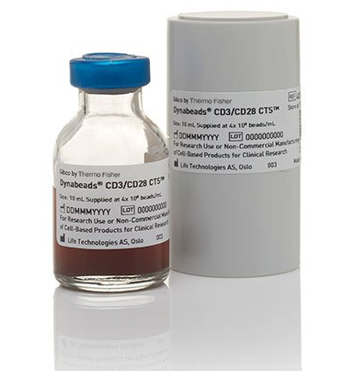
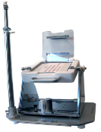
Technology Ready for Commercial Manufacturing of T Cells
CTS Dynabeads CD3/CD28 magnetic beads
CTS DynaMag Magnet
Intended for:
Intended for:
Isolation, activation, and expansion of CD3⁺CD28⁺ T cells
Isolation of T cells by CTS Dynabeads CD3/CD28 magnetic beads
Remove CTS Dynabeads CD3/CD28 magnetic beads
Key benefits:
Key benefits:
Aseptic manufacturing in compliance with cGMP
Used in >88 clinical trials and in the manufacturing of
FDA-approved CAR T cell products
Global regulatory support and DMFs
Single use
Flexible and scalable
Static separation: 50–330 mL
Continuous flow separation

Slide 7
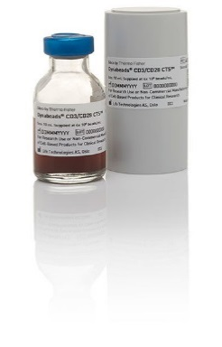
CTS Solution for T Cell Isolation and Activation for T Cell Manufacturing
Isolate | CTS Dynabeads CD3/CD28 magnetic beads
Activate | CTS Dynabeads CD3/CD28 magnetic beads
Day 0—43.7%
Day 3—96.4%
Day 10—99.7%
Activates >95% of the CD3⁺CD28⁺ isolated T cells
CD3
CD25
Isolates CD3⁺CD28⁺ expressing naïve and early memory T cells
Purity of CD3⁺ T cells: >95%
Expanded T cells express
central memory phenotype (CD62L⁺, CD28⁺)
Recovery of CD3⁺CD28⁺
T cells: >90%

Slide 8
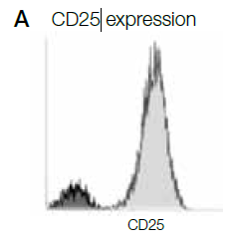
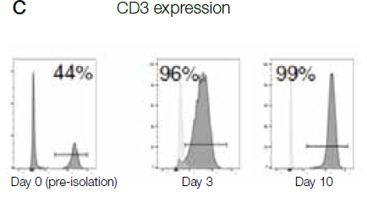
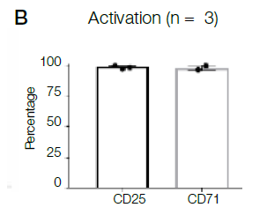
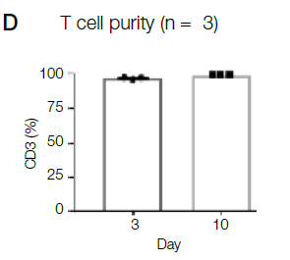
Scalable Technology for Robust Isolation & Activation of T Cells
ACTIVATION
PURITY
High expression of activation markers
High purity
Notes:
Enables efficient activation and high T cell purity

Slide 9
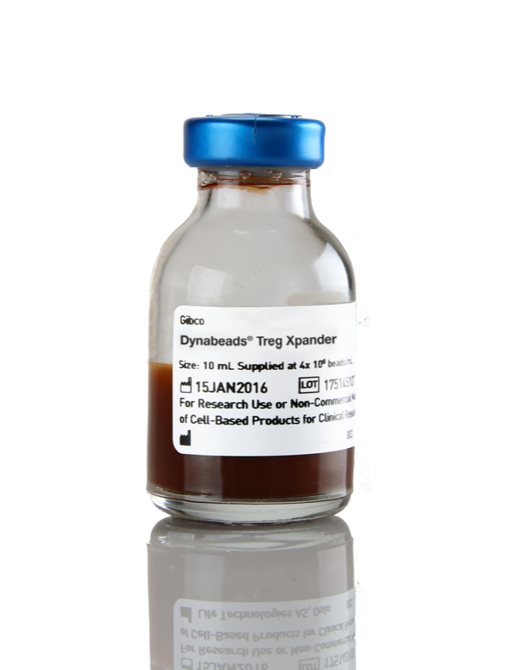
Solving Challenges—Superior Expansion of Regulatory T Cells
Challenge
Innovation: our solution
Can we activate and expand Regulatory T cells (Tregs) from patients with autoimmune diseases for clinical research?
CTS Dynabeads Treg Xpander
Dynabeads Technology Enables:
Expansion of arelevant number of Tregs
Maintenance of Treg phenotype
FoxP3
  IL-10
  Demethylated TSDR
Maintenance of Treg function (Suppression of conventional T cells)
Stable Treg phenotype (demethylation of TSDR)
Notes:
Demethylated TSDR: Stable Foxp3 expression is achieved through epigenetic modification of the Treg-specific demethylated region (TSDR), an evolutionarily conserved non-coding element within the Foxp3 gene locus.

Slide 10
High Fold Expansion of Tregs with CTS™ Dynabeads™ Treg Xpander
YIELD
60-72% FoxP3*
96-97% FoxP3*
PHENOTYPE
Fold expansion
Fold Expansion
PURITY
Day
CTS™Dynabeads™ Treg Xpander
CTS™OpTmizer + CTS™ Immune Cell SR
CTS™Dynabeads™ CD3/CD28
Competitor medium + CTS™ Immune Cell SR
Competitor product
%
FoxP3
High fold expansion numbers of Tregs
Increased expansion with CTS OpTmizer & ICSR
*Variation in FoxP3 is due to different donors, starting material and protocols

Slide 11
Functional Tregs Expanded with Dynabeads™ Treg Xpander
FUNCTION
% Suppression
pg/mL
Treg : PBMC
Cytokines
4:1 CTS™ Dynabeads™ Treg Xpander
4:1 CTS™ Dynabeads™ Treg Xpander
1:1 CTS™ Dynabeads™ Treg Xpander
1:1 CTS™ Dynabeads™ Treg Xpander

Slide 12
Gene-Modified T Cell Manufacturing Workflow
Cell isolation
and activation
Cell
engineering
Cell
expansion
Wash, fill,
finish, and cryo
Lot release and characterization
Isolation/activation beads and magnet
Lentiviral
production systems
Catalog and
custom media
Wash
Safety, identity, and
purity testing
Electroporation device
Human serum replacement
Cryopreservation medium
Functional analysis
Gene editing
Growth factors
Cellular analysis
Single-use technologies
Protein analysis
Genetic analysis
Notes:
In the gene modified T cell manufacturing workflow we have products that support each step of the workflow.
Presentation will go through key products but it is not an exhaustive list

Slide 13
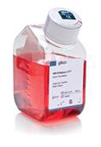
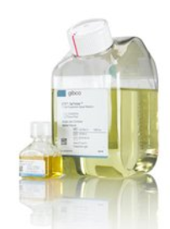
CTS T Cell Media Options
Gibco™ CTS™ OpTmizer™ T Cell Expansion SFM is our
next-generation T cell culture and expansion medium
Gibco™ CTS™ AIM V™ medium
is the first commercially available, defined, serum-free formulation for proliferation and manipulation of T cells
Gibco™ CTS™ OpTmizer™
T Cell Expansion Serum-Free Medium is designed to provide results equivalent to
conventional serum-supplemented media
Notes:
Add publication references to this slide. (Kite paper, Chinese paper from 2018)
Need to harmonize slide with others in the deck. Challenge, Innovation/Solution type frame up.

Slide 14
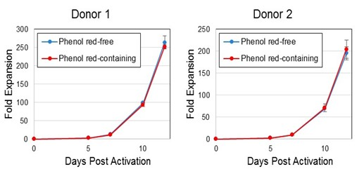
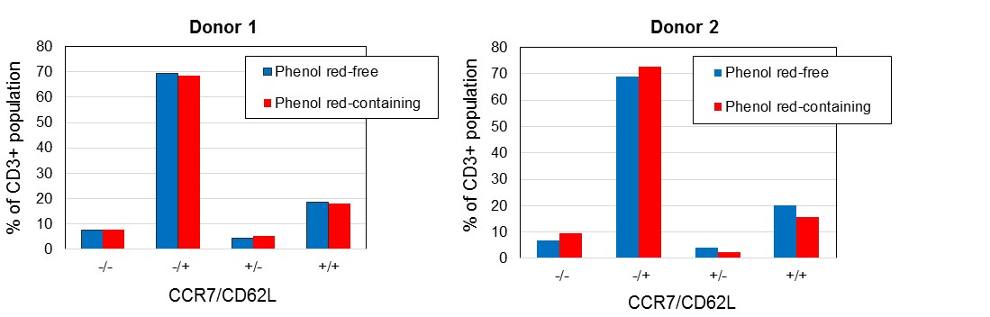
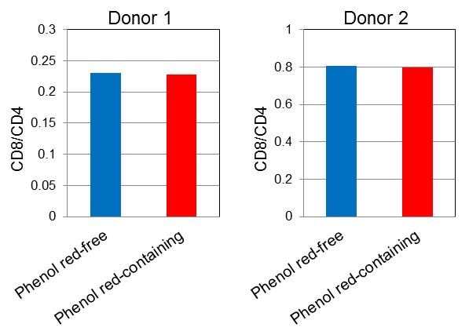
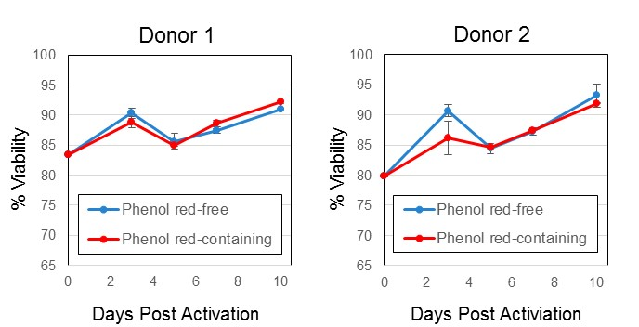
Absence of Phenol Red Does Not Impact Performance
YIELD
PHENOTYPE
VIABILITY
DIFFERENTIATION
High-fold expansion and viability
High viability with no difference in phenotype

Slide 15
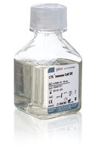
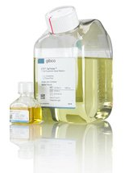
Solving Challenges — Robust Serum-Free Expansion of T Cells
Challenge
Innovation: serum-free media
Process Performance
Can a serum-free media replace the use of human AB serum?
Serum Performance
Undefined composition
Lot-to-lot variability
Lot qualification cost
Serum Safety
Potential for adventitious agents
Serum Supply Chain
Limited supply of human AB serum
Superior T cell expansion
Serum-free
Desirable phenotype
Balanced CD4/CD8
CTS OpTmizer T Cell
Expansion Serum-Free Medium
OpTmizer
OpTmizer + 2% ICSR
Competitor SFM
Competitor + 5% hAB
+
CTS Immune Cell
Serum Replacement
* Error bars represent standard deviations for multiple donors examined in triplicate.
** The data are representative of three independent experiments/unique donors.

Slide 16

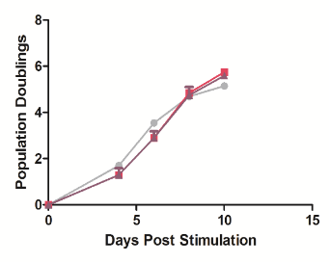
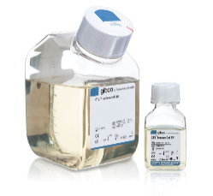
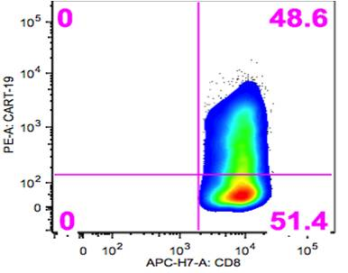
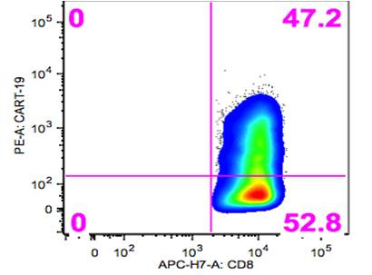
CTS Solution for T Cell Expansion
Population doublings
  Supports T cell activation using Dynabeads magnetic beads
  and stimulatory antibody–presenting cell protocols in various manufacturing process platform (WAVE, G-Rex)
  Supplementation of media with CTS ICSR is as effective
  as human serum for expanding T cells
Days post-population
Expansion
CAR T cells transduced
CTS OpTmizer T Cell Expansion SFM
5% hABS
5% CTS Immune Cell SR
  Supplementation of media
  with CTS ICSR supports similar
  CAR T19 cell expression as
  serum-supplemented medium
CAR T cell expression
CTS ICSR
Acknowledgement
We thank James L. Riley and Andrew Medvec from the University of Pennsylvania Department of Microbiology for their support in generating these data.

Slide 17
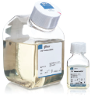

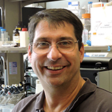

Solving Challenges — Improved In Vivo Function of T Cells by a Serum-Free Medium
Challenges of Serum
Innovation: serum-free media improve T cell function
Serum-Free Media Improve Tumor Control
Persistence
Which manufacturing process parameters influence productivity and long-term persistence of engineered T cells; essential for clinical success
Day 1
Day 13
Day 49
Serum-free medium promotes
CART-19 5% ICSR
CART-19 5% hAB
1
Durable control of tumors
-
5% hAB UNT
-
-
-
-
-
-
-
-
2
Lot to lot variability of serum influence CAR T cell transduction efficiency
Serum Effect Transduction Efficiency
Control
HuAB serum #1
HuAB serum #2
% GFP +
HuAB serum #3
HuAB serum #4
HuAB serum #5
Collaboration with:
Dr. James L. Riley
HuAB serum #6

Slide 18
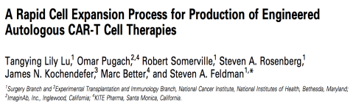

Rapid CAR T Cell Expansion: CTS Culture Media Optimization
CTS ICSR supplementation resulted in higher levels of lymphocyte
growth and expansion for all media evaluated
CTS OpTmizer medium + CTS ICSR was selected
for T cell growth and expansion
Article link
1.5 x 10⁸
Cells cultured in CTS OpTmizer T Cell Expansion SFM (with 5% CTS ICSR) compared to
AIM V supplemented
with 5% human serum (HS)
1.0 x 10⁸
Fully defined medium that demonstrates little lot-to-lot variability,
allowing for more consistent product manufacturing
Cell number
5.0 x 10⁷
0
CTS™ Optimizer ™ T-Cell Expansion SFM
X-VIVO™ Media
TexMACS™
GMP Medium
AIM V™ Medium
The manufacturing process described will allow this promising
adoptive cell transfer therapy to enter multicenter clinical trials
Cells cultured in medium (with 5% CTS ICSR) compared to AIM V supplemented w/ 5% HS
CTS OpTmizer T Cell Expansion SFM: For human ex vivo tissue and cell culture processing applications. CAUTION: When used as a medical device, Federal Law restricts this device to sale by or on the order of a physician. CTS ICSR: For Research Use or Manufacturing of Cell, Gene, or Tissue-Based Products. CAUTION: Not intended for direct administration into humans or animals.
CTS OpTmizer medium + CTS ICSR was used in multicenter CAR T clinical trials
Notes:
Additional experiments comparing OpTmizer CTS supplemented with either 2.5% or 5% TCSR for lymphocyte expansion showed no difference in cell expansion. OpTmizer CTS-2.5% TCSR was therefore selected for T-cell growth and expansion in subsequent studies.

Slide 19
CTS Custom Media Options
Summary
Support levels
Full service | Complete turnkey solution All labwork and testing performed in Grand Island, NY Final media prototype provided for client evaluation Additional phases for media formatting and packaging optional
Consultation | Joint collaboration We design experiments and formulate prototype media Client performs cell culture work and transfers data to us We analyze the data and optimize formulations
Panel service | Access to library of custom formulations Rapid customization Evaluation with consultative support Nonexclusive, simplified terms and conditions Path to custom media orders or further optimization
Custom media development and optimization, custom packaging
for media and reagents, and options for media format
Multiple levels of support are available to meet your needs
Key benefits
Collaborative process yielding solutions tailored
to fit your cells and endpoints
Exclusive access to formulations developed via consultative
and full-service contracts
Full ISO design control standards met through service offerings
Adaptable process that can be modified as new data are discovered
Work conducted in R&D and easily transferred to cGMP
Indications and product information
Over 25 years of experience in media development
Over 110 projects successfully completed
Notes:
Key Message: We offer three different formats for our custom media development: Full service, Consultation and Panel Service. This process does not require the product to meet the CTS specifications, but if it does, it can get the CTS label.
Full service: Turnkey but expensive. We do everything in house and give them a media back. (typically cell therapy companies do not select this because of price)
Consultation: Provide prototypes based on their inputs, they do all the testing and send us the data and we go through this iterative process until we arrive at a formulation that works for their need.
Panel Service: Panel approach. We have a preset selection of media for each cell type. We send them media and supplements. They experiment with them and let us know which formulation they want to purchase. Easy and cost free way for them to get access to custom alternates, if they don’t have something off the shelf that’s work for them.
Support levels
Full service
Complete turn-key solution
All lab work and testing performed in Grand Island, NY
Final media prototype provided for client evaluation
Additional phases for media formatting and packaging optional
Consultation
Joint collaboration
We design experiments and formulate prototype media
Client performs cell culture work and transfers data to us
We analyze data and optimize formulations
Panel service
Access to library of custom formulations
Rapid customization
Evaluation with consultative support
Non-exclusive, simplified terms and conditions
Path to custom media orders or further optimization

Slide 20
Gene-Modified T Cell Manufacturing Workflow
Cell isolation
and activation
Cell
engineering
Cell
expansion
Wash, fill,
finish, and cryo
Lot release and characterization
Isolation/activation beads and magnet
Lentiviral
production systems
Catalog and
custom media
Wash
Safety, identity,
purity testing
Electroporation device
Human serum replacement
Cryopreservation medium
Functional analysis
Gene editing
Growth factors
Cellular analysis
Single-use technologies
Protein analysis
Genetic analysis
Notes:
In the gene modified T cell manufacturing workflow we have products that support each step of the workflow.
Presentation will go through key products but it is not an exhaustive list

Slide 21
Lentivirus (LV) Production Systems
Vector construction
Vector production
Vector purification
Invitrogen™ GeneArt™ Elements™ construction
Flexible
Reliable
Easy to use
Lipofectamine 3000
Transfection Reagent
Adherent
High titer: even with genes
that are large or difficult to package
Gentle: reduced reagent dose
for improved cell viability
Flexible: compatible
with your existing protocol
Cost-effective: use less
ancillary product and labor
Next-generation LV
production system
Suspension
High titer: greater than
1 x 10⁸ TU/mL (unconcentrated)
Scalable: bioreactor-compatible suspension culture
GMP manufacturing:
active development program
Thermo Scientific™ POROS™, CaptureSelect™, and Affinity™ matrices
Scalable
High specificity, purity, and yield
Quality
Notes:
Key Message: Here is a summary of our lentiviral capabilities.
Vector Construction (Gene Art): we can help them construct the plasmids and other needs to construct their virus.
Vector Production: We offer a complete solution for high titer and cost-effective adherent and suspension vector production.
Most companies that are using lentivirus production systems are using adherent cell systems (i.e. Lipofectamine 2000CD or Lipofectamine 3000) and are getting titers in 10^6 to 10^7 range.
As patient volumes increase, manufacturers will need to move to suspension systems.
High titers mean decrease volume. They can scale for increased patient volumes.
Vector Purification (BAC/Poros): BAC and Poros are combining efforts to create BAC Ligands that they can attach to Poros Resins for affinity purification as custom projects. Very interested in looking at viral purification. AAV2 and AAV5 columns (created by BAC and distributed via GE) and AAV8 and AAV9 (created by BAC/Poros and sold via Thermo Fisher) are quickly becoming the industry standard. If your customers are interested in purification, please let us know.
Transition: I’d like to talk a bit more about our vector production capabilities and share some performance data.

Slide 22
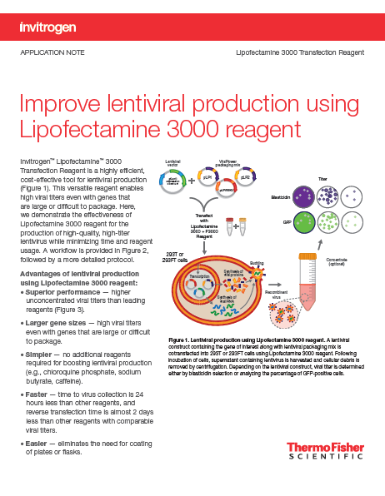
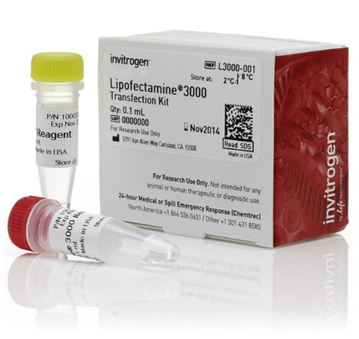
LV Production: Technology Recommendation
Adherent LV production
Reagent
4e+08
Lipofectamine 3000 Transfection Reagent
3e+08
2e+08
1e+08
0e+00
thermofisher.com/lentiviral
Adherent cells HEK 293T/17

Slide 23
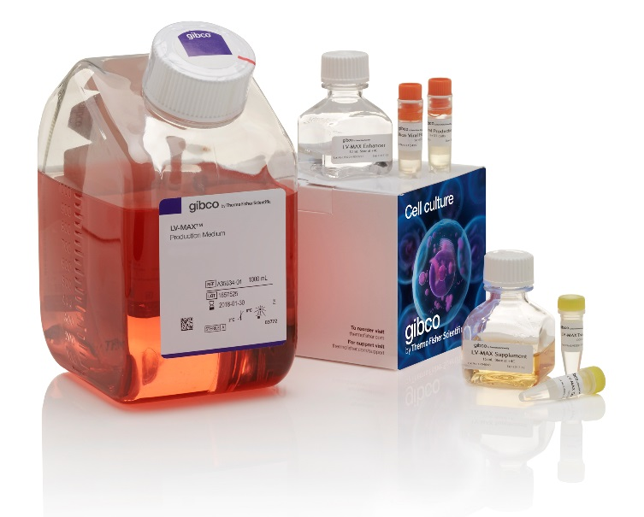
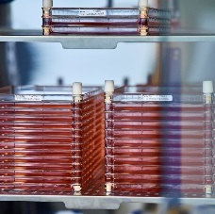
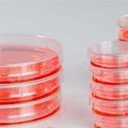
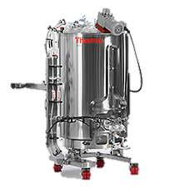
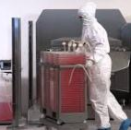

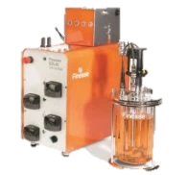
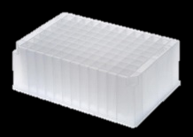


Solving Challenges — Scalable and Cost Effective Lentiviral Production
Challenges
Innovation: integrated and scalable production system
Production system
Challenging to scale
High titers
Suspension system
GMP available
Low productivity
Adherent culture
Low-titers
Cells, medium, and Gibco™ LV-MAX™ Lentiviral Production System
Regulatory support
200 L
10 L L
2 L
Safety
Serum-containing media
0.8 L
1 mL
30 mL

Slide 24
Efficient and Cost-Effective LV Production
… resulting in a cost reduction of over 50%
compared to PEI-based lentiviral production methods.
The LV-MAX system produced 15x more virus than the
PEI-mediated system in adherent cells and 10x more virus than in suspension cells …
Switch to LV-MAX system and save*
58%
52%
LV production: PEI vs. LV-MAX system
1.50e+8
1.20e+8
on adherent PEI
on suspension PEI
9.00e+7
LV titer (TU/mL)
6.00e+7
3.00e+7
* Cost comparison based on list price in USD and LV yield of 1 x 10⁸ TU/mL using LV-MAX and 1 x 10⁷ TU/mL
using PEI-based adherent and suspension methods. Cost consideration includes media, transfection reagents,
and culture vessels.
0.00e+0
PEI adherent
PEI suspension
LV-MAX suspension
LV system
Increased viral titer compared to other production methods. Unfiltered lentivirus produced by suspension cells using the
LV-MAX Lentiviral Production System was compared with PEI-mediated transfection of lentiviral vectors in adherent HEK 293T/FT cells and suspension HEK 293 cells. The lentiviral titer was determined by transducing HT1080 cells and analyzing GFP-positive cells. The LV-MAX system offers a higher titer and a cost reduction of over 50% compared to PEI-based lentiviral production methods.

Slide 25
Gene-Modified T Cell Manufacturing Workflow
Cell isolation
and activation
Cell
engineering
Cell
expansion
Wash, fill,
finish, and cryo
Lot release and characterization
Isolation/activation beads and magnet
Lentiviral
production systems
Catalog and
custom media
Wash
Safety, identity,
purity testing
Electroporation device
Human serum replacement
Cryopreservation medium
Functional analysis
Gene editing
Growth factors
Cellular analysis
Single-use technologies
Protein analysis
Genetic analysis
Notes:
In the gene modified T cell manufacturing workflow we have products that support each step of the workflow.
Presentation will go through key products but it is not an exhaustive list

Slide 26
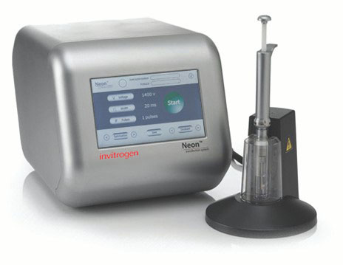

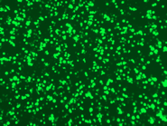
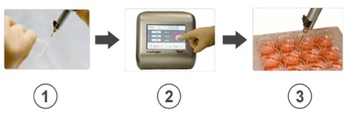
Neon Electroporation Device
Summary
Primary T cells—DNA delivery
The Neon electroporation
device offers greater transfection efficiency and helps decrease hands-on time.
Day 3 T cells
1
2
3
3
5
7
10
Time (days)
Introduction of DNA by electroporation with the Neon Transfection System
produced over 80% transfection efficiency in primary T cells

Slide 27
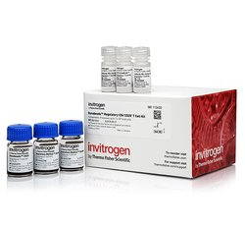

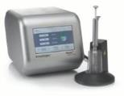
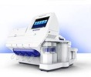
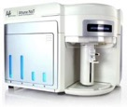

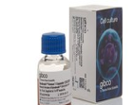
Robust Editing Efficiency in Primary T cells—Neon Delivery System
  End-to-end solution for T cell editing needs:
Healthy donor-derived T cells transfected with TrueCut Cas9 v2 and TrueGuide synthetic gRNA (sgRNA)(em dash)targeting cell receptors alpha (TRAC) or beta (TRBC). After isolation and activation, T cells were transfected.
T cell isolation and activation
Transfection
Indel cleavage efficiency
24 hr
48 hr
Dynabead-based kits
TrueCut Cas9 + TrueGuide sgRNA
Neon Transfection System
Analyze% TCR (–) cells
Invitrogen™ Attune™ NxT Flow Cytometer

Slide 28
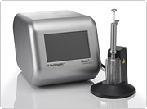
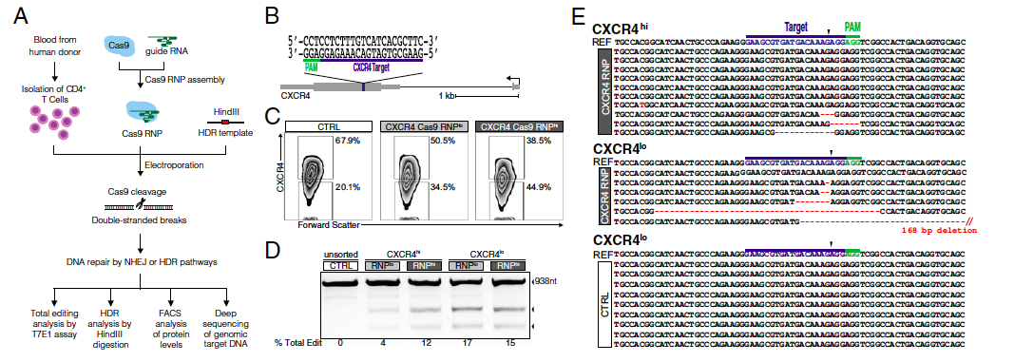
Publication
  Generation of knock-in primary human T cells
  using Cas9 ribonucleoproteins
Kathrin Schumann , Steven Lin , Eric Boyer, Dimitre R. Simeonov , Meena Subramaniam Rachel E. Gate, Genevieve E. Haliburton, Chun J. Ye , Jeffrey A. Bluestone , Jennifer A. Doudna and Alexander Marson
A
B
E
References Neon system
as electroporation device
C
2.5 x 10⁵ T cells in 10 µL tip
1,600 V, 10 ms, 3 pulses
D
% total edit
Proc Natl Acad Sci USA 112:10437 (2015).
Notes:
University of California

Slide 29
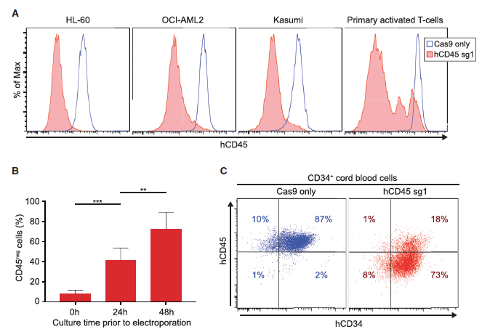
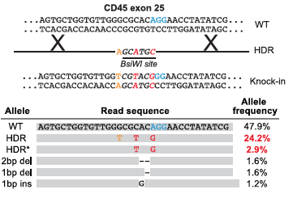
Publication
  Highly efficient genome editing of murine and human hematopoietic progenitor cells by CRISPR/Cas9
Michael C. Gundry, Lorenzo Brunetti, Angelique Lin, Allison E. Mayle, Ayumi Kitano, Dimitrios Wagner, Joanne I. Hsu, Kevin A. Hoegenauer, Cliona M. Rooney, Margaret A. Goodell, and Daisuke Nakada
Efficient CD45 Knockout in
Human Hematopoietic Cells
CRISPR-Cas9-Mediated Gene Disruption
and HDR in Human HSPCs
References Neon system
as electroporation device
% of max
2.5 x 10⁵ T cells in 10 µL tip
1,600 V, 10 ms, 3 pulses
Cell Reports 17:1453 (2016).
Notes:
Baylor college of Medicine, Houston, TX

Slide 30
Gene-Modified T Cell Manufacturing Workflow
Cell isolation
and activation
Cell
engineering
Cell
expansion
Wash, fill,
finish, and cryo
Lot release and characterization
Isolation/activation beads and magnet
Lentiviral
production systems
Catalog and
custom media
Wash
Safety, identity,
purity testing
Electroporation device
Human serum replacement
Cryopreservation medium
Functional analysis
Gene editing
Growth factors
Cellular analysis
Single-use technologies
Protein analysis
Genetic analysis
Viral and nonviral solutions are available
Notes:
In the gene modified T cell manufacturing workflow we have products that support each step of the workflow.
Presentation will go through key products but it is not an exhaustive list

Slide 31
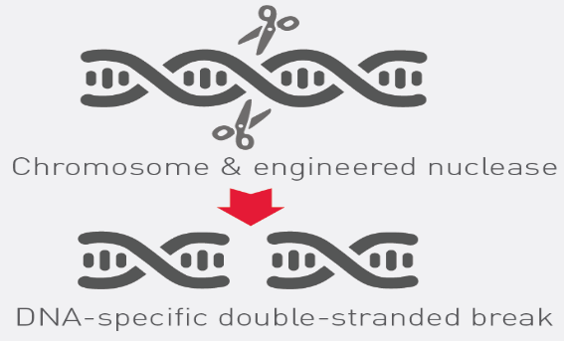

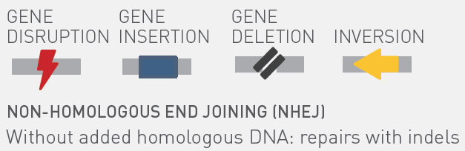
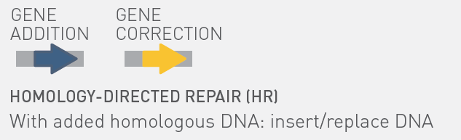
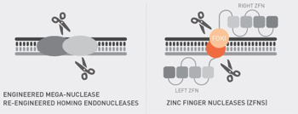
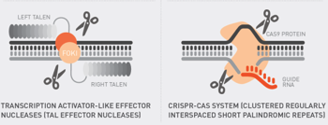
Genome editing with designer engineered nucleases
Cell’s repair mechanism is harnessed to heal DNA breaks
Traditional methods
Modern
Notes:
Engineered nucleases, such as CRISPR or TALs can be designed to target nucleases to specific sites in the genome, creating double-strand breaks (DSBs) at desired locations. The natural repair mechanisms of the cell heal the break by either homologous recombination (HR) or non-homologous end-joining (NHEJ). HR is more precise, since it requires a template, allowing the introduction of foreign DNA into the target gene. DSB repair by NHEJ is likely to introduce errors such as insertions or deletions (indels), leading to a non-functional gene and respective knock out cell lines.
For instance, endonucleases linked to customized DNA binding proteins can produce highly targeted DNA double-stranded breaks (DSBs). DSBs induce endogenous DNA repair mechanisms, typically non-homologous end joining (NHEJ) or homology-directed repair (HDR). NHEJ is prone to errors and often introduces a frame-shift mutation if it occurs within the coding sequence of a protein-coding gene. Homologous DNA “donor sequences” can be used with HDR to introduce a defined new DNA sequence.

Slide 32
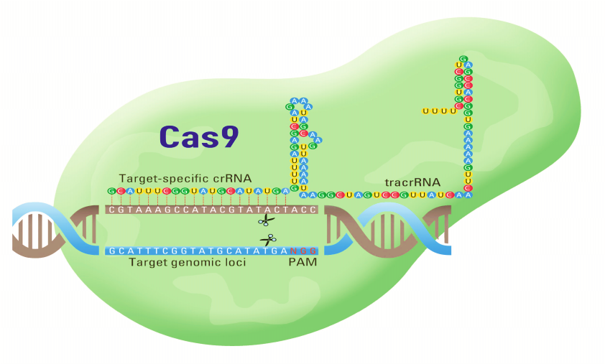
CRISPR/ Cas9
CRISPR Cas9 protein
Cas9 mRNA
CRISPR gRNA
CRISPR lentiviral libraries

Slide 33




CRISPR/Cas9 Formats for Gene Editing to Functional Genomics Screening
RNP Format
Cas9 Formats
Invitrogen™ TrueCut™
Cas9 Protein V2
Invitrogen™ GeneArt™
Cas9 mRNA
Invitrogen™ GeneArt™
CRISPR/Cas9 plasmid
Invitrogen™LentiArray™
Cas9 Lentivirus
gRNA Formats
Invitrogen™ TrueGuide™
Synthetic gRNA
Invitrogen™LentiArray
gRNA Lentiviral libraries

Slide 34


The TrueTag Workflow
4 linear plasmids for each kit
Tag = EmGFP or RFP or Luciferase
- N puro/Tag
- N blast/Tag
- C Tag/puro
- C Tag/blast
Phusion Flash High-Fidelity PCR Master Mix
GeneJet PCR Cleanup kit
Positive control primers for ACTB
Prep Kit
Cleanup kit

Slide 35





Easily create accurate and more successful knock-in experiments
Invitrogen
TrueDesign Genome Editor
Search for your gene
Easily navigate the human genome to find the exact transcript and loci you want to modify
Craft your edit
View the DNA and amino acid sequences while editing your gene with point-and-type features
Available now!
thermofisher.com/truedesign
Complete your design
TrueDesign will generate your specific donor and the associated CRISPR-Cas9 gRNA sequences

Slide 36

Search for your gene

Slide 37


Craft your edit

Slide 38




Complete your design
Download all data in a single report
gRNA sequence (& TALEN sequences)
Donor ssODN
Sequencing primers
Minimal left and right homology arms
Download

Slide 39
Easily create accurate and more successful knock-in experiments
Invitrogen
TrueDesign Genome Editor
Search for your gene
Easily navigate the human genome to find the exact transcript and loci you want to modify
Craft your edit
View the DNA and amino acid sequences while editing your gene with point-and-type features
Available now!
thermofisher.com/truedesign
Complete your design
TrueDesign will generate your specific donor and the associated CRISPR-Cas9 gRNA sequences

Slide 40


Genome Editing in Primary Human T-Cells
α
β
Figure reference: Dana-farber.org
Ex vivo non-viral editing of Human T Cells is the next step of CAR-T therapy. This requires knocking out key endogenous genes (TRAC, TRBC) and then adding back a chimeric antigen receptor (CAR) construct specific to the cancer type
Adapted from www.junotherapeutics.com/the-science/car-technology

Slide 41







CRISPR-Cas9 Gene Editing in Donor Derived T-Cells, TCR Knock-Out
24 hours
48 hours
T cell isolation and activation
Dynabead based kits
T cell transfection
TrueCut Cas9+TrueGuide sgRNA
Neon transfection
Analyze %TCR –ve cells
Attune NxT Flow cytometer
Untransfected sample
+ TRAC T1 gRNA /Cas9 RNP
+ TRBC T1 gRNA/Cas9 RNP
+ TRBC T1 gRNA/Cas9 RNP
TCR-PE
Notes:
Tested two targets per T cell receptor alpha and beta domain (TRAC T1 and T2 or TRBC T1 nd T2 sgRNA) and see > 80% and in one case up to 90% targeting efficiency as measured by Attune flow cytometry.

Slide 42





CRISPR-Cas9 Gene Editing in Donor Derived T-Cells, Donor Knock-In
24 hours
48 hours
Day3 T cells
Cas9 V2, 1ug
gRNA: 250ng
TrueTag Donor DNA: 1ug
Neon Program: #24
T cell isolation and activation
Dynabead based kits
T cell transfection
TrueCut Cas9+TrueGuide sgRNA
TrueTag Donor DNA
Neon transfection
Analyze %TCR –ve cells
Attune NxT Flow cytometer
β-actin locus
Buffer R
Buffer C-17
RAB11A locus
Buffer R
Buffer C-17
5% GFP+
29% GFP +
31.7% GFP +
45.6% GFP +
SSC-A
SSC-A
GFP (KI efficiency)
GFP (KI efficiency)
ACTB locus
ATG
RAB11A locus
ATG
ACTB exon 2
RAB11A exon 1
Notes:
TrueTag knock-in’s for ACTB and RAB11A. Both constructs were designed towards the N-terminal of the respective gene. Buffer C-17, a derivative of Neon Buffer R, significantly increased the KI rate at both loci.

Slide 44

GRCF Seminar Series
Thank you for attending!
To follow the GRCF Seminar Series, please visit us at: grcf.jhmi.edu
    To order ThermoFisher products/services at the GRCF contact:
          Core Store: https://grcf.jhmi.edu/core-store/

