Slide 1
QIAGEN Modern Multimodal Approaches to Liquid Biopsy Analysis
Steven Bass, MS
Senior Genomics Specialist
MidAtlantic
Prepared for:
GRCF Seminar Series
Jan 17, 2020, MRB G-01
Steven.Bass@qiagen.com
Notes:
Hello, I am …. In this presentation I would like to share very exciting results of research study about multimodality approaches in Liquid biopsy. The study was carried out at the University Hospital Essen in Germany in collaboration with QIAGEN R&D.

Slide 2
Legal disclaimer
QIAGEN products shown here are intended for molecular biology applications. These products are not intended for the diagnosis, prevention or treatment of a disease.
For up-to-date licensing information and product-specific disclaimers, see the respective QIAGEN kit handbook or user manual. QIAGEN kit handbooks and user manuals are available at www.qiagen.com or can be requested from QIAGEN Technical Services or your local distributor.

Slide 3
Agenda
Introduction
Multimodality in liquid biopsies – a 5-arm study (ELIMA)
*New The Power of One: True Multimodal NGS Library Construction & Panels
*New QIAseq Targeted Methyl-Seq Panels
Summary
Appendix Discussion
digital PCR by QIAGEN
Epidemiology Research aka Sequencing by Subtraction
Notes:
Let’s get started with an introduction into liquid biopsy

Slide 4
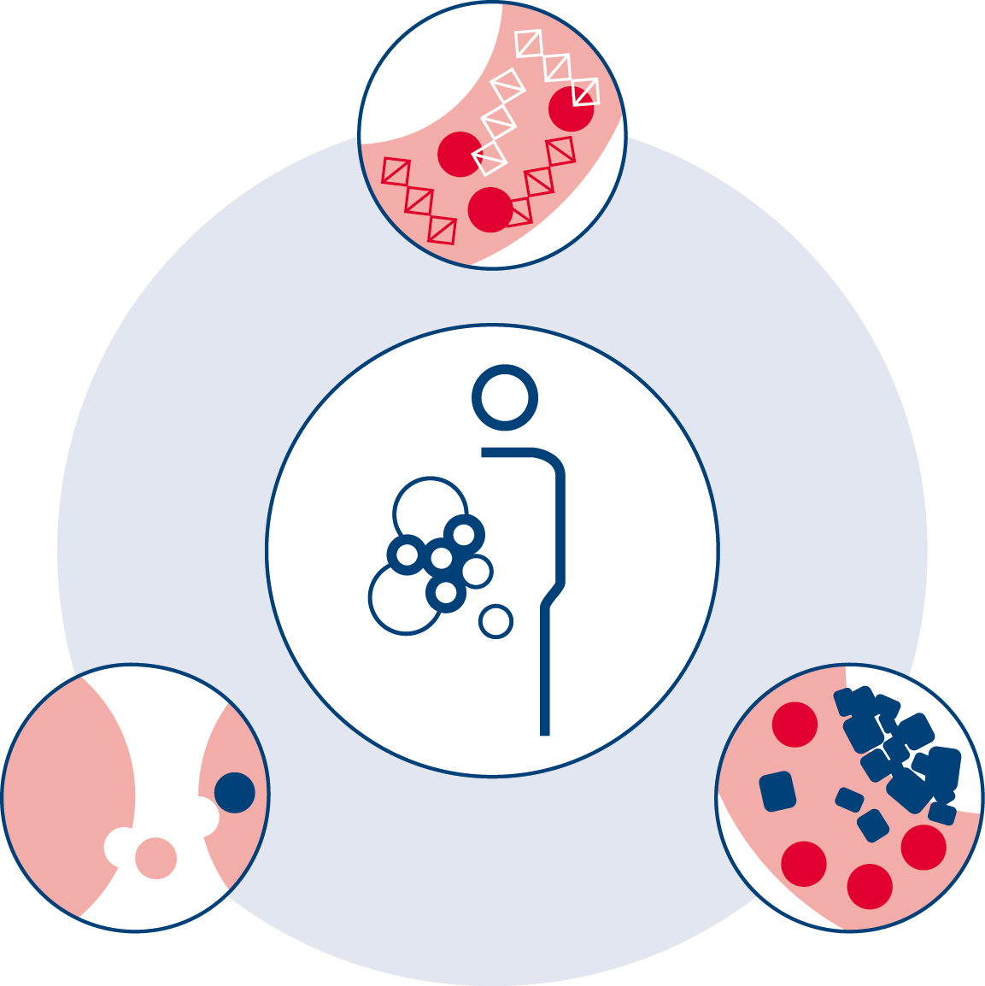
The value of multimodality approaches in liquid biopsy research and analysis
Circulating, cell-free nucleic acids Get the information from tumor or metastatic tissue after necrotic processes which could also cover therapeutic effects, hypoxia or body defense reactions and inflammatory processes
Circulating, cell-free nucleic acids
RNA and DNA from dead cells shed into the bloodstream; can contain cancer-related mutations
Exosomes
Tiny microvesicles found in body fluids that transport RNA between cells
Circulating tumor cells (CTC)
Tumor cells shed from a tumor into the bloodstream carrying genetic information
Do we miss (or even waste) genomic and transcriptomic information by considering only one analyte?
If several analytes are considered, can they be compared if they do not come from one sample?
How would the picture change if all analytes could be investigated from the same sample?
Exosomes
Collect information about regulation processes and potential interaction between tumor lesions; understand the communication between metastatic locations or between the primary tumor and metastasis via EVs in the microenvironment
Circulating tumor cells (CTCs) Understand metastasis formation, resistance mechanisms and potential therapeutic targets by getting insight into the molecular metabolism of the living seed of metastasis
Towards a comprehensive understanding of cancer.
Notes:
We asked ourselves at the beginning, if we miss we (or even waste) genomic and transcriptomic information by considering only one analyte and how the picture would change if all analytes could be analyzed from one sample. Overall our multimodality approach in the ELIMA study is the path towards comprehensive understanding of cancer. Each analyte showed synergistic potential for managing therapy in the future:
ccfDNA which enables us to get the information from tumor or metastatic tissue after necrotic processes
CTCs that drive our understanding of metastasis formation, resistance mechanisms and potential therapeutic targets
And extracellular vesicles which allow to collect information about regulation processes and to understand the communication between metastatic locations or between the primary tumor and metastasis.
The comprehensive picture of the genomic and transcriptomic complexity might enable to identify the most suitable therapy for each individual in the future.

Slide 5
Sample preparation: A total RNA solution for every sample type
Cells, fresh tissue and frozen tissue
miRNeasy Mini Kit
miRNeasy Micro Kit
miRNeasy 96 Kit
FFPE tissue
miRNeasy FFPE Kit
Fluids (serum, plasma, urine, CSF and saliva)
miRNeasy Serum/Plasma Kit
Exosome enrichment/isolation from serum/plasma
exoRNeasy Serum/Plasma Midi Kit
exoRNeasy Serum/Plasma Maxi Kit
PAXgene Blood miRNA Kit
PAXgene Tissue miRNA Kit

Slide 6
Solving exosome mysteries – now also in Urine samples!
We extended the utility of the exoRNeasy Kit to urine samples
The modified column-based RNA isolation allows efficient analysis of mRNAs and miRNAs for up to 16 ml urine (incl. first morning urine).
We demonstrate highly reproducible detection of internal and external reference mRNAs.
Co-isolation of inhibitors with the small RNA fraction is effectively prevented by addition of Reagent UI
Solving exosome mysteries!
New – protocol for Urine
Notes:
Hidden mysteries in exosome can now also be solved from urine samples.
We extended the utility of the exoRNeasy Kit to urine samples
The modified column-based RNA isolation allows efficient analysis of mRNAs and miRNAs for up to 16 ml urine (incl. first morning urine).
We demonstrate highly reproducible detection of internal and external reference mRNAs.
Co-isolation of inhibitors with the miRNA fraction is effectively prevented by addition of Reagent UI
Let’s help our customers to solve hidden mysteries in exosome from urine samples and help them with the discovery of new disease or cancer RNA biomarker!

Slide 7
Agenda
Introduction
Multimodality in liquid biopsies – a 5-arm study (ELIMA)
True Multimodal NGS Library Construction
Targeted Methyl-Seq
Summary
Notes:
So the study is about multimodality analyses in liquid biopsies and is set up as a 5-arm study

Slide 8
The ELIMA study
ELIMA: Evaluation of Multiple Liquid Biopsy Analytes In Metastatic Breast Cancer Patients All from One Blood Sample
Scope:
Identify potentially predictive and prognostic biomarkers for scientific insights
Develop an optimized workflow for isolation and analysis of multiple parameters: CTCs, EVs and cfDNA from one blood sample
Achieve one condensed workflow to minimize the blood volume needed
Minimize sample-to-sample bias while getting the complete transcriptomic and genomic information
Establishment of a workflow for the analysis of mRNA and gDNA from circulating tumor cells, extracellular vesicles and cell-free DNA from the same blood sample to mirror the genomic and transcriptomic complexity in metastatic breast cancer subjects
Corinna Keup¹, Markus Storbeck², Peter Hahn², Siegfried Hauch², Markus Sprenger-Haussels², Ann-Kathrin Bittner¹, Oliver Hoffmann¹, Mitra Tewes³, Rainer Kimmig¹ and Sabine Kasimir-Bauer¹
Department of Gynecology and Obstetrics, University Hospital of Essen, Germany;
QIAGEN GmbH, Hilden, Germany;
Department of Medical Oncology, University Hospital of Essen, Germany
Poster presented at AACR 2019 (Products shown in this poster are intended for molecular biology applications)
Notes:
The study is called ELIMA which stands for
Evaluation Of Multiple Liquid Biopsy Analytes In Metastatic Breast Cancer Patients All From One Blood Sample
The study was carried out at the University Hospital Essen in Germany with Corinna Keup and Sabine Kasimir-Bauer and in collaboration with QIAGEN R&D (Siggi’s team).
The scope of the study was to identify predictive and prognostic biomarkers
To develop an optimized workflow for isolation and analysis of multiple analytes: CTCs, EVs and cfDNA from one blood sample.
To achieve one condensed workflow to minimize the blood volume needed.
And to minimize sample to sample bias while getting the complete transcriptomic and genomic information.
There are already three publications that are a result of the study (you will see them on the upcoming slides) and the work has as well been presented by Corinna Keup at AACR this year.

Slide 9
Study plan
Plasma
EV mRNA
RT-PCR
EV
CTC mRNA
RT-PCR
CTC lysate
One
individual
CTC
Blood
CTC gDNA
NGS
CTC-depleted plasma
ccfDNA
NGS
ccfDNA
Plasma
ccfDNA
NGS
Notes:
You see on this slide the study plan that was set up to look at different analytes all from the same individual and to establish the complex workflows. It is a 5 arm study, analysing:
1. mRNA from extracellular vesicles (exosomes)
2. mRNA from CTCs (Circulating Tumor Cells)
3. gDNA from CTCs
4. Circulating cell-free DNA from CTC depleted plasma
5. ccfDNA from plasma
We will go into more details of each individual arm in the next slides.
As stated before the overall goal was to develop a workflow that allows the analysis of the different analytes from the same blood sample.
(Note for the speaker: use the term “same blood sample” to emphasize that the samples ( blood collection tubes) are from one individual taken at the same time point. So we have multiple blood tubes but same blood sample.)

Slide 10
Sampling and workflow focus
Sampling:
Blood samples from individuals with metastatic breast cancer with HR+ HER2– primary tumors
EDTA blood from 35 individuals
Blood sample at 3 time points
T0 (progressive disease)
+ T1 (consecutive staging)
+ T2 (consecutive staging)
Parallel analysis of:
mRNA from EVs
mRNA from CTCs
gDNA from CTCs
ccfDNA from plasma
ccfDNA from CTC-depleted plasma
Notes:
For the ELIMA study, blood samples from 35 individuals with metastatice breast cancer (MBC) were collected.
The cohort has the following primary tumor characteristics:
The women are all hormone receptor positive (HR+) and they are negative for expressing and / or overamplifying the growth factor receptor HER2, they are HER2 negative
So it is a very stringent, clearly defined cohort
Blood was collected from individuals at the time of disease progression (T0) and at two consecutive clinical staging time points (T1 and T2) during therapy.
These samples were used to analyse mRNA from Evs - extracellular vesicles, mRNA from CTCs, gDNA from CTCs, ccfDNA from plasma and ccfDNA from CTC depleted plasma.
Note: Her2 = name of protein: human epidermal growth factor receptor 2, (ERBB2= name of gene, official name))
Expressing estrogen (ER) and /or progesteron (PR) receptor = hormone receptor positive (HR+)

Slide 11
Methods overview
Input | Biomarker | Biomarker isolation/extraction method | Analysis method | Data analysis and biological interpretation
Plasma | EV (mRNA) | ExoRNeasy | Custom AdnaPanel TNBC | Expression analysis
Blood | CTC (mRNA) | AdnaTest EMT-2/StemCell
Blood | CTC (gDNA) | AdnaTest EMT-2/StemCell AllPrep CTC prototype | PyroMark Q48 Autoprep QIAseq Targeted DNA Custom Breast Cancer Panel | CLC Genomics Workbench Ingenuity Variant Analysis
Plasma | ccfDNA | QIAamp MinElute ccfDNA
The products listed are intended for research applications
Notes:
On this slide, you see an overview on the methods used in the study the table shows what input material, extraction method, analysis method and data analyis and/or interpretation tool was used for the different biomarkers
Please note the CTC gDNA isolation method is currently an AllPrep prototype kit.
The CTC mRNA PCR detection method is a custom AdnaPanel – our AdnaTest system offers dedicated catalogued panels, e.g., the AdnaTest ProstateCancerPanel AR-V7 or the AdnaTest LungCancer for multiplex PCR detection. However the AdnaTest is an open system that can be used to analyse additional targets of interest by using own primers.
For targeted NGS analysis a QIAseq custom panel was used. Details of the panel follow in one of the next slides.

Slide 12
Agenda
Introduction
Multimodality in liquid biopsies – a 5-arm study (ELIMA)
Study arms – concepts and findings
Notes:
The next few slides will show the concept of the individual arms in more details.

Slide 13
Study arm 1: RNA profiles of CTCs and extracellular vesicles
Plasma
EV mRNA
RT-PCR
EV
CTC mRNA
RT-PCR
CTC lysate
One
individual
CTC
Blood
CTC gDNA
NGS
CTC-depleted plasma
ccfDNA
NGS
ccfDNA
Plasma
ccfDNA
NGS
Notes:
The goal of the frist arm of the ELIMA study was to develop a workflow to isolate mRNA from CTCs and extracellular vesicles (EVs) from the same blood draw and to compare the mRNA profiles of CTCs and extracellular vesicles (EVs).

Slide 14
Study arm 1: RNA profiles of CTCs and extracellular vesicles
Custom AdnaPanel TNBC targeting AKT2, ALK, AR, AURKA, BRCA1, EGFR, ERCC1, ERBB2, ERBB3, KIT, KRT5, MET, mTOR, NOTCH1, PARP1, PIK3CA, SRC, GAPDH; normalization to CD45 as leukocyte control and healthy donors
Plasma
EV mRNA
RT-PCR
4 ml, 2x centrifuged, filtered
exoRNeasy
EV
CTC mRNA
RT-PCR
AdnaTest EMT-2/ StemCell
CTC lysate
AdnaTest EMT-2/
StemCell
CTC
One
individual
2 x 9 ml EDTA blood
Blood
CTC gDNA
NGS
CTC-depleted plasma
ccfDNA
NGS
ccfDNA
ELIMA
cohort n=35
Plasma
ccfDNA
NGS
Notes:
Here you see the methods used in this study arm: exoRNeasy as affinity-based spin column technology to isolated total RNA from EVs from pre-filtered plasma. CTCs isolated from blood by immunomagnetic selection using the AdnaTest EMT2/StemCell product – the Select part of it. The Detect part of the AdnaTest EMTT2/StemCell product was used to isolate the mRNA from EVs total RNA and from the CTC lysates. The mRNA from both sources was then analysed by a custom multimarker qPCR AdnaPanel.

Slide 15
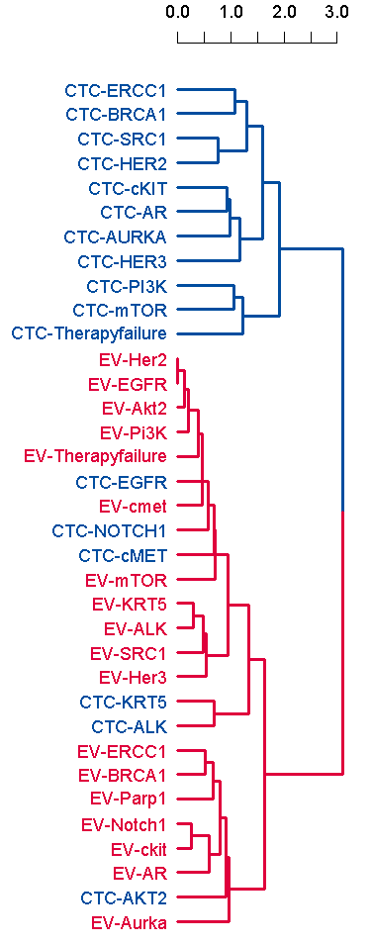
CTC- and EV-derived mRNAs provide independent information
EV
CTC
Transcripts cluster primarily by their origin
CTCs and EVs share only a small number of transcripts
Notes:
The results of the first study arm and the comparison of the mRNA profiles from EVs and CTCs indicate great differences.
The data show
That transcripts cluster primarily by their origin (origin means CTC or EV)
That CTCs and EVs share only a small number of transcripts
You see that from the Venn diagram on the left (a low number of transcripts is shared by both CTCs and EVs). And you see it in the cluster diagram on the right. The CTC transcripts in blue mainly cluster together and the EV transcripts in red mainly cluster together..
So, CTC-derived and EV-derived mRNAs provide independent information. RNA analysis of EVs and CTCs does not seem to be competitive, but rather complementary.
Note:
Name of diagrams: Venn diagram left and cluster diagram right
Scale in the cluster diagram is delta CT
The few CTC transcripts that cluster with the EV transcripts (the blue ones in the red cluster) are very low abundant transcripts, they are sorted into the EV cluster by the algorithm – they can be seen as outliers

Slide 16
Differences between mRNA profiles from CTCs and EVs
Overexpression frequency in subject cohort (%)
All subjects in this study were initially staged negative for ERBB2 (Her2) expression
ERBB2 (Her2) overexpressing CTCs were found in 40% of all MBC subjects which points to a de novo Her2 positivity and a phenotype change
Keup C. et al. (2018) RNA profiles of circulating tumor cells and extracellular vesicles for therapy stratification of metastatic breast cancer patients. Clin. Chem. 64, 1054.
Notes:
On this slide you see more about the substantial differences in the mRNA profiles of CTCs and EVs. The graphic is showing the overexpression frequency of several target genes (overexpression in the context of EVs means overrepresentation). mRNA overexpression frequency in CTCs is shown in light blue color, EV mRNA overrepresentation frequency in dark blue color
Let’s have a closer look at ERBB2
As mentioned in the cohort description all women in this study were initially negative for ERBB2 (Her2) expression.
ERBB2 is still negative in the mRNA profile from EVs but not in the CTC mRNA profile. ERBB2 overexpressing CTCs were found in 40% of all MBC subjects which points to a de novo Her2 positivity and a phenotype change. This could be potentially a new opportunity for future therapeutic options.
Another examples is the mTOR expression, it differs in CTCs and EVs, the expression in CTCs is much higher. For the AurKA (Aurora Kinase) expression in EVs is much higher compared to CTC.
The ELIMA study revealed more findings on those two targets which we are going to show you in the next two slides.
Note:
Her2 = name of protein
ERBB2= name of gene

Slide 17
mRNA profiles from CTCs and EVs show different effects
A
B
CTC and EV mRNA profiles show substantial differences, correlating with therapy outcomes:
Overexpression of mTOR in CTCs is related to therapy responsiveness (A)
mTOR signals in EVs are related to therapy failure (B)
Keup C. et al. (2018) RNA profiles of circulating tumor cells and extracellular vesicles for therapy stratification of metastatic breast cancer patients. Clin. Chem. 64, 1054.
Notes:
We just learned that CTC and EV mRNA profiles showed substantial differences related to the overexpression or overrepresentation of the gene mTOR.
But the ELIMA study also revealed that mRNA profiles from CTCs and EVs are different with regard to their clinical relevance - so comparing the samples that come from subjects with different response to therapy.
Whereas overexpression of mTOR in CTCs (positive signal, dark blue fraction in the bar chart A) was related to therapy responsiveness (the fraction of overall responders that show mTOR overexpression is much higher than the fraction of overall non-responders).
mTOR signals in EVs (positive signal, dark blue fraction in bar chart B) was related to therapy failure. (Here the fraction of the overall responders that show mTOR overexpression is much lower than the fraction for Overall non-responders)
Note:
Data are statistically relevant, see paper

Slide 18
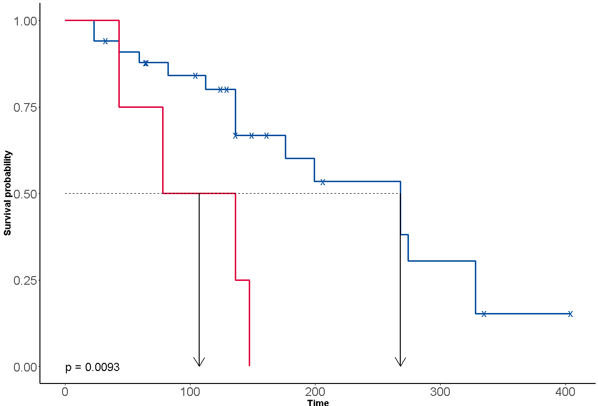
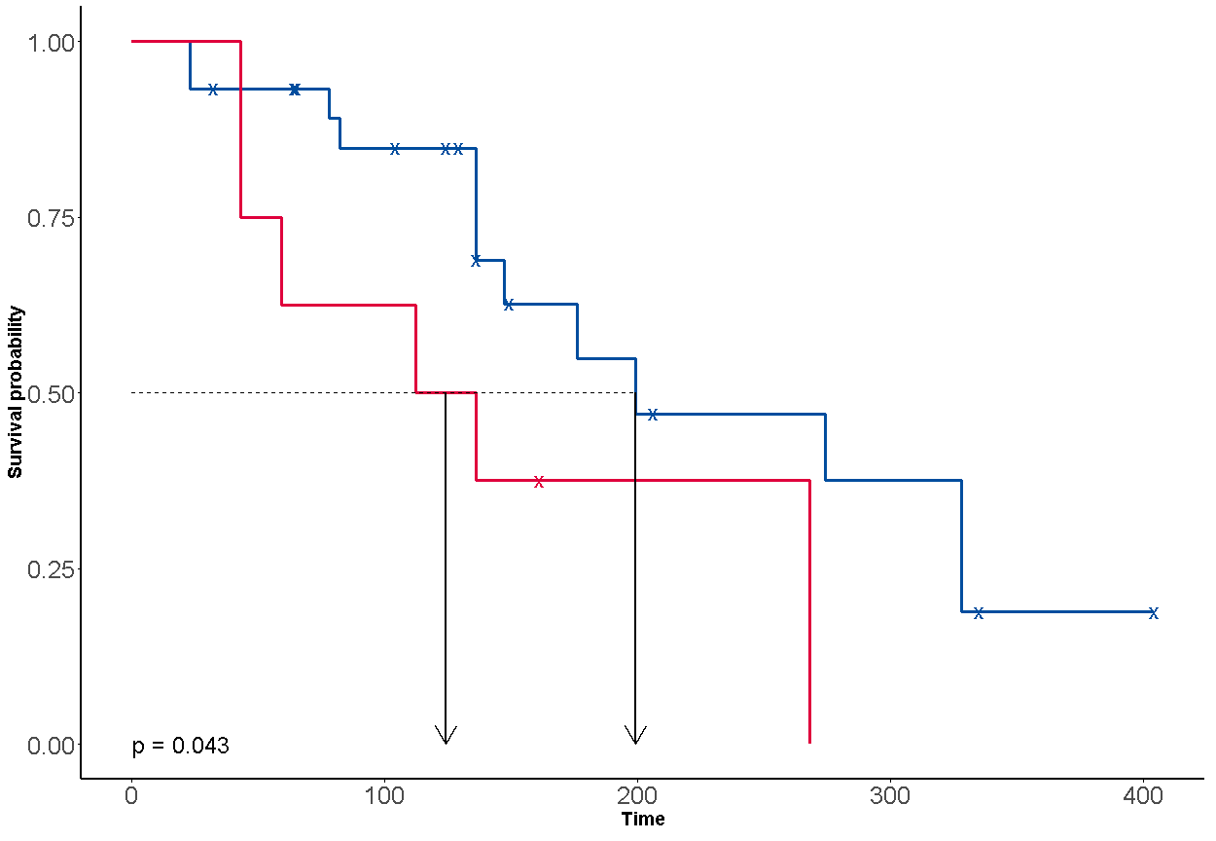
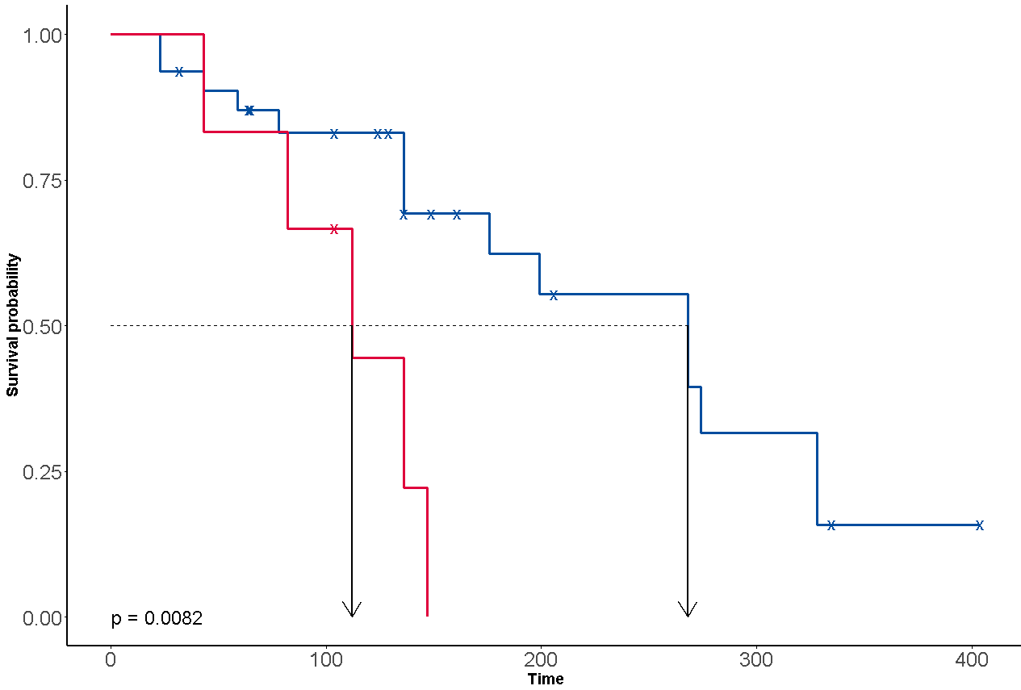
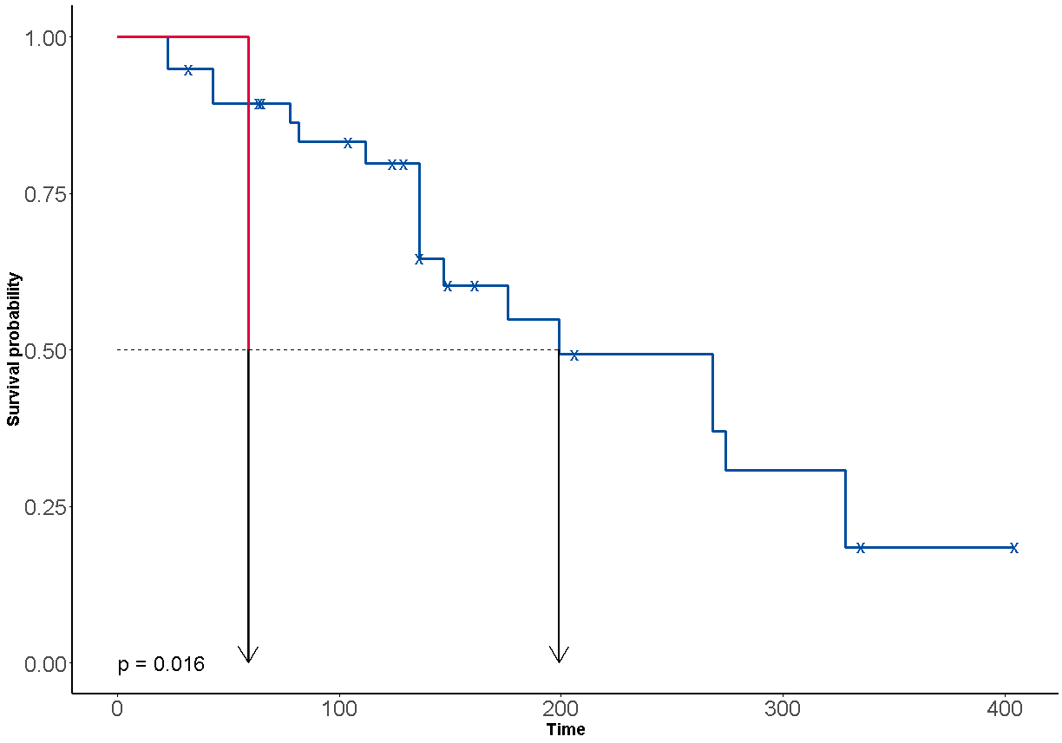
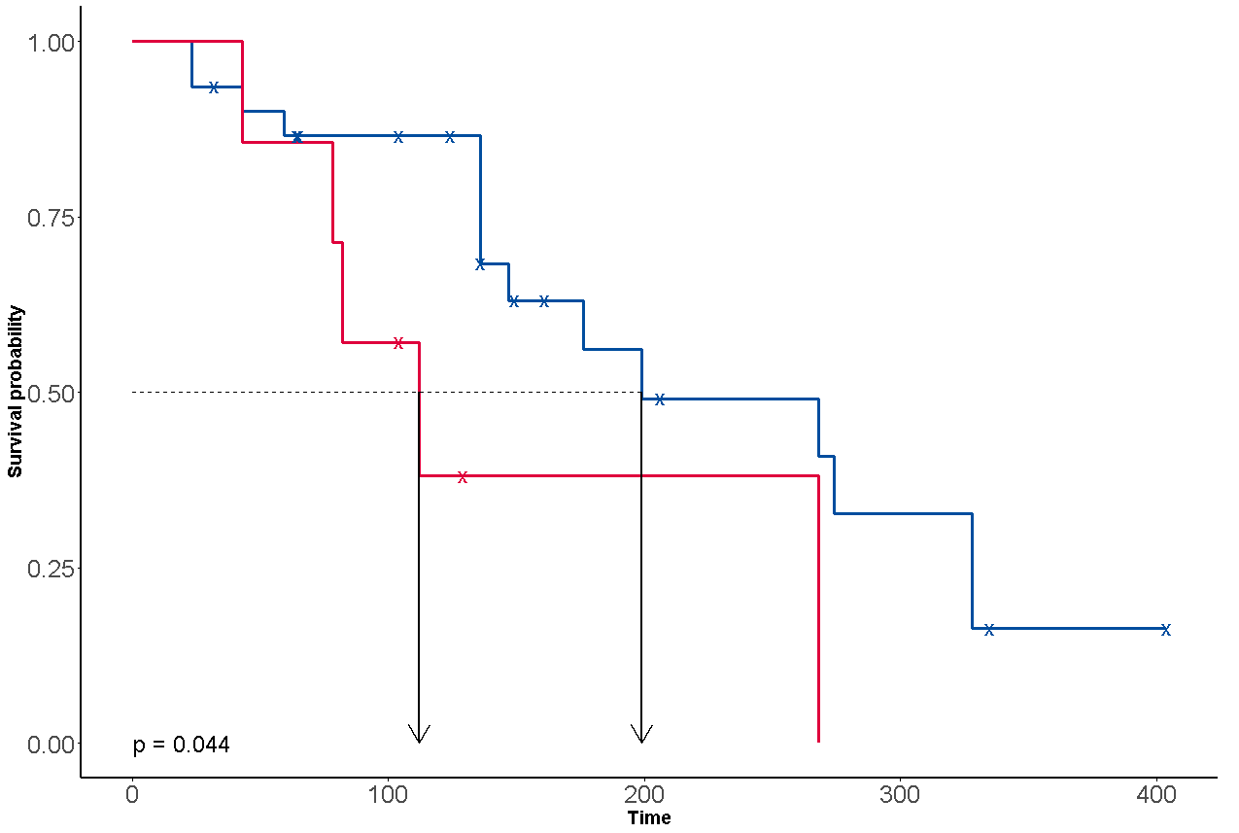
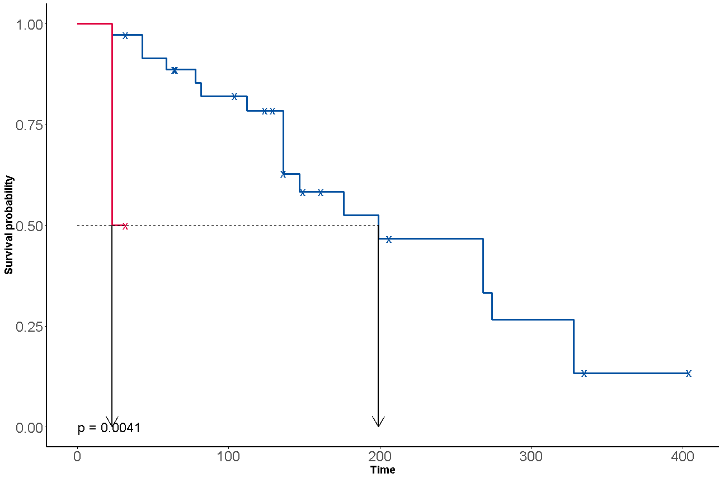
Survival analysis of EV AURKA positive samples
CTC, ERBB2
⁰
¹
CTC, ERBB3
⁰
¹
CTC, SRC
⁰
¹
Time = months
0 = negative
1 = positive
x = censored
CTC, NOTCH1
⁰
¹
EV, BRCA1
⁰
¹
EV, MET
⁰
¹
Statistical analysis of samples with Aurora A Kinase gene overexpression in EVs:
ERBB2, ERBB3, SRC or NOTCH1 overexpression in CTCs and BRCA1 or MET overexpression in EVs are negatively correlated with survival probability
These are all genes with high impact in cancer research, underlining a potential interaction between the tumor and CTCs and EVs in tumor proliferation and metastasis
Notes:
Here you see results related to Aurora Kinase:
The slide shows statistical analyses of samples with Aurora Kinase overexpression in EVs. It is a survival analysis of EV Aurora Kinase positive samples.
Without going into detail, so that there is a strong negative correlation between survival probability of individuals that express certain genes in CTCs or EVs. These are all genes with high impact in cancer research. These results only show up in this cohort (so in the EV AuroraKinase positive samples) pointing to an interaction between EVs and CTCs.
To sum up this study arm: Looking at RNA profiles from EVs and CTCs do provide a much more comprehensive picture than just looking at one of those analytes.
Backup info:
ERBB2, ERBB3 are genes coding for growth factor receptors
SRC is a non receptor tyrosine kinase, which may play a role in cell growth
NOTCH1 is a transmembrane receptor involved in signaling pathways
BRCA1, the „Breast cancer gene“ known to increase probability of malignancy
MET is a tyrosine kinase receptor triggering cell proliferation
Kaplan Meier curves:
These are Kaplan Meier curves, the x axis is the time in months, the y axis the survival probability
The blue line shows survival probability in case of biomarker negative individuals (legend 0, means gene is not expressed),
The red line shows survival probability in case of biomarker positive individuals (legend 1 means: marker is expressed)
Let‘s take the upper left Kaplan Meier curve as an example: individuals who are positive for overexpressing ERBB2 in CTCs (the red line) show lower survival propability compared to individuals that are negative for ERBB2 overexpression in CTCs (the blue line). The red line drops earlier (in this case at about 150 months)
0=negative = marker not expressed
1=positive = marker expressed
x=censored (see crosses on curves – these are events marked on the curves at which an individual left the study)

Slide 19
Study arm 2: Establish a cell-free DNA NGS workflow
Plasma
EV mRNA
RT-PCR
EV
CTC mRNA
RT-PCR
CTC lysate
One
individual
CTC
Blood
CTC gDNA
NGS
CTC-depleted plasma
ccfDNA
NGS
ccfDNA
Plasma
ccfDNA
NGS
Notes:
The goal of the 2nd arm of the ELIMA study was to establish a cell-free DNA NGS workflow.

Slide 20
Study arm 2: Establish a cell-free DNA NGS workflow
Plasma
EV mRNA
RT-PCR
EV
CTC mRNA
RT-PCR
CTC lysate
One
individual
CTC
1 x 9 ml EDTA blood
Blood
CTC gDNA
NGS
QIAseq Targeted DNA Custom Panel targeting AKT1, AR, BRCA1, BRCA2, EGFR, ERBB2, ERBB3, ERCC4, ESR1, KRAS, FGFR1, MUC16, PIK3CA, PIK3R1, PTEN, PTGFR and TGFB1; NextSeq® runs with mean coverage of around 16,000x
CTC-depleted plasma
ccfDNA
NGS
ccfDNA
Independent HR+ HER2-
cohort n=44
Plasma
QIAamp® MinElute ccfDNA Kit
4 ml, 2x centrifuged
ccfDNA
NGS
Notes:
As this arm was dedicated to establish the cfDNA NGS workflow an indpendent cohort was used.
For this study arm 1x 9ml whole blood from one individual was used to generate 4 ml of plasma. cfDNA extration was perfromed using the QIAamp MinElute ccfDNA Mini Kit. QIAseq Targeted DNA Custom Panel; targeting AKT1, AR, BRCA1, BRCA2, EGFR, ERBB2, ERBB3, ERCC4, ESR1, KRAS, FGFR1, MUC16, PIK3CA, PIK3R1, PTEN, PTGFR and TGFB1; NextSeq runs with mean coverage of around 16.000x

Slide 21
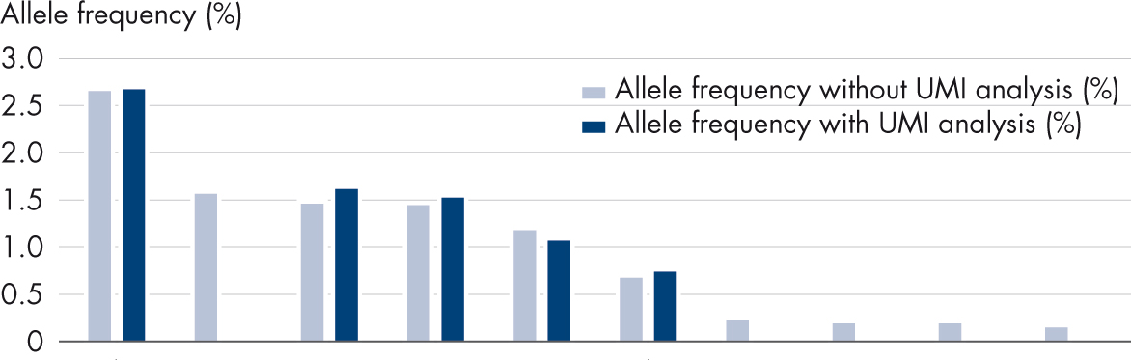
Impact of DNA input and unique molecular indices (UMIs)
 | E545K | H1047R | H1047R | H1047R | H1047R | E545K | P539S | H1047R | H1047R | H1047R
 | Case 22 | Case 6 | Case 53 | Case 31 | Case 3 | Case 15 | Case 46 | Case 42 | Case 5 | Case 40
Allele frequency without UMI analysis (%) | 2.66 | 1.56 | 1.46 | 1.45 | 1.18 | 0.68 | 0.22 | 0.20 | 0.20 | 0.15
Allele frequency with UMI analysis (%) | 2.67 | 0 | 1.62 | 1.52 | 1.06 | 0.72 | 0 | 0 | 0 | 0
cfDNA input (%) | 60 | 7 | 12 | 60 | 60 | 60 | 29 | 6 | 28 | 2
Read fragments per UMI | 2.0 | 14.1 | 17.2 | 7.7 | 4.5 | 2.8 | 10.9 | 11.7 | 18.8 | 24
UMI coverage | 6403 | 230 | 888 | 684 | 4499 | 6351 | 2066 | 1662 | 152 | 449
Mean coverage x 1000 | 15.3 | 3.2 | 19.5 | 5.3 | 26.9 | 21.5 | 28.7 | 26.8 | 2.8 | 14.7
UMIs increase specificity; 50% of variants were confirmed by UMI analysis
High cfDNA input, high UMI coverage and low ratio of read fragments per UMI are crucial for UMI detection
Keup C. et al. (2019) Targeted deep sequencing revealed variants in cell‑free DNA of hormone receptor‑positive metastatic breast cancer patients. Cellular and Molecular Life Sciences
Notes:
As a result you see here a comparison of called PIK3CA hotspot variants with and without unique molecular indices (UMIs). Only cases with variant AFs < 3% are examined.
Dark blue bars in the graph show the allele frequency with UMI analysis. Light blue bars show the allele frequency without UMIs. The key take away of this slide is that UMIs increase specificity, 50% of variants can be confirmed by UMI analysis (arrows). UMIs enabled the verification of true positive mutations and maximized stringent conclusions.
The table gives a bit more details on sample input and NGS characteristics per case. The key findings here is that high cfDNA input, as well as a high UMI coverage and a small ratio of read fragments per UMI are crucial for successful detection of variants with UMIs.
Note:
Read fragments per UMI means the number of fragments that share the same UMI ( and can be seen as PCR duplicates)
UMI coverage – the number of unique reads that cover the sequence of the UMI

Slide 22
Impact of cfDNA variants
Longitudinal monitoring of case 39: Only pathogenic and likely-pathogenic mutants plotted
Cumulated altered fragment count
Time point 1 Time point 2 Time point 3 Time point 4 Time point 5 Time point 6
Afinitor + Aromasin Eribulin
Biopsy of primary tumor Stable disease Stable disease Progress Stable disease Progress
Pathogenic cfDNA variants vary over the course of the disease and may reflect the evolution of a mutation profile due to different interventions
Keup C. et al. (2019) Targeted deep sequencing revealed variants in cell‑free DNA of hormone receptor‑positive metastatic breast cancer patients. Cellular and Molecular Life Sciences
Notes:
We looked further into the relevance of the cfDNA variants that were found by analysing the NGS data.
You see multiple pathogenic and likely-pathogenic variants that are identified with cfDNA NGS analysis. The graphic shows how they develop over time in one subject (case 39)
Pathogenic cfDNA variants vary over the course of the disease and may reflect the evolution of a mutation profile due to different interventions. You see that mainly PIK3CA and ESR1 mutations show up which could be correlated with resistance building to the drugs that have been used here in therapy.
Very interesting as well is, time point 3 marked with the red arrow: Already in stable disease status you see pathogenic mutation start to show up. So the rise of mutations can be already detected in cell free DNA even before disease progression is seen.
This is a strong indication that cfDNA variants may allow for earlier decisions in potential future therapy stratification.

Slide 23
Study arm 3: Comparison of ccfDNA from naive or CTC-depleted plasma
Plasma
EV mRNA
RT-PCR
EV
CTC mRNA
RT-PCR
CTC lysate
One
individual
CTC
Blood
CTC gDNA
NGS
CTC-depleted plasma
ccfDNA
NGS
ccfDNA
Plasma
ccfDNA
NGS
Notes:
The scope of the 3rd arm of the ELIMA study was to see if CTCs and cfDNA can be subsequently isolated from the same blood sample.
Final goal is to get rid of a separate workflow for cfDNA NGS analysis starting from naive plasma. If this is possible this would be the frist step towards analysing multiple analytes in the same workflow from the same blood tube.

Slide 24
Study arm 3: Comparison of ccfDNA from naive or CTC-depleted plasma
Plasma
EV mRNA
RT-PCR
EV
CTC mRNA
RT-PCR
CTC lysate
One
individual
CTC
2 x 9 ml EDTA blood
Blood
CTC gDNA
NGS
QIAseq Targeted DNA Custom Panel targeting AKT1, AR, BRCA1, BRCA2, EGFR, ERBB2, ERBB3, ERCC4, ESR1, KRAS, FGFR1, MUC16, PIK3CA, PIK3R1, PTEN, PTGFR and TGFB1; NextSeq® runs with mean coverage of around 16,000x
CTC-depleted plasma
ccfDNA
NGS
4 ml, 2x centrifuged
QIAamp MinElute ccfDNA Kit
ccfDNA
Independent HR+ HER2-
cohort n=17
Plasma
ccfDNA
NGS
Notes:
The study arm starts with whole blood. CTCs were depleted from the blood using AdnaTest EMT-2/StemCell and then the blood sample without CTCs (CTC depleted blood) was used to generate plasma. In parallel plasma from whole blood was generated as well. Both types of plasma samples (the one coming from CTC depleted blood and the other from naïve samples were both further processed for ccfDNA isolation and next generation sequencing as described in the study arm before.

Slide 25
Comparison of ccfDNA from naive or CTC-depleted plasma
ccfDNA variants from whole blood and CTC-depleted blood
No significant difference between the two ccfDNA sources
Keup C. et al. (2019) Cell-free DNA variant sequencing using ctc-depleted blood for comprehensive liquid biopsy testing in metastatic breast cancer. Cancers 11(2), 238
Notes:
Here you see the comparison of cfDNA variants coming from whole blood (WB) = naïve plasma and CTC-depleted blood (CTC-depl.B). The analysis revealed no significant difference between the two ccfDNA sources.
You see that from the boxplots on the left and right. They are describing the number of detected cfDNA variants (either the total amount of variants per subject in A or the number of variants that are exclusive per subject in graph B). The sources for cfDNA are either whole blood (the boxplot in blue) or CTC-depleted blood (the boxplot in grey). There is no significant difference in the amount between the two sample types.
In addition the Venn diagram in the middle shows that there is a great overlap of identical variants found in both cfDNA sources, you see the number of variants that are shared by the two cfDNA sources whole blood or CTC depleted blood is very high.
The results confirm that a subsequent isolation of CTCs and cfDNA from the same blood collection tube is possible with minor impact on the variant pattern, meaning you can first take out the CTCs and then use the CTC-depleted plasma for NGS analysis– a separate ccfDNA NGS analysis workflow from naive Plasma is not required

Slide 26
Study arm 4: Analysis of ccfDNA variants from CTC-depleted plasma
Plasma
EV mRNA
RT-PCR
EV
CTC mRNA
RT-PCR
CTC lysate
One
individual
CTC
Blood
CTC gDNA
NGS
CTC-depleted plasma
ccfDNA
NGS
ccfDNA
ELIMA
cohort n=35
Plasma
ccfDNA
NGS
Notes:
As we have just learned CTC-depleted plasma is suitable for cell-free DNA NGS sequencing – a separate ccfDNA analysis workflow from naive Plasma is not required.
In study arm 4 the focus was now on the in-depth analyis of the cfDNA variants found in plasma from CTC depleted blood.

Slide 27
ccfDNA variants in plasma from CTC-depleted blood
Classification (n=76)
Gene location of pathogenic or likely pathogenic variants (n=26)
One quarter of all detected variants are known pathogenic variants
Among them, most variants occurred in AR, PIK3CA and ESR1
Keup C. et al. (2019) Establishment of a workflow for the analysis of mRNA and gDNA from circulating tumor cells, extracellular vesicles and cell-free DNA from the same blood sample to mirror the genomic and transcriptomic complexity in metastatic breast cancer subjects. Poster presented at AACR, 2019.
Notes:
The in-depth analysis of cfDNA variants in CTC-depleted blood shows that one quarter of all detected variants are known pathogenic variants. Among them, most variants occurred in AR, PIK3CA and ESR1. These are well known variants in cancer research. And you may remember we have as well seen PIK3CA and ESR1 variants as main variants showing up in the results of the cfDNA NGS workflow study arm.
Backup info:
AR, androgen receptor
BRCA1, the „Breast cancer gene“ known to increase probability of malignancy
ESR1, estrogen receptor 1
PTEN, acts as a tumor suppressor gene
PIK3CA, code for subunit of a kinase, involvd in the regulationof several hormones, important for many cell activities includiung cell growth and didvison
Benign = not harmful

Slide 28
cfDNA variants in plasma from CTC-depleted blood
Mutations in ESR1 and PIK3CA correlate with a lower survival probability
Keup C. et al. (2019) Establishment of a workflow for the analysis of mRNA and gDNA from circulating tumor cells, extracellular vesicles and cell-free DNA from the same blood sample to mirror the genomic and transcriptomic complexity in metastatic breast cancer subject. Poster presented at AACR, 2019.
Notes:
Further survival probability analysis of ESR1 and PIK3CA variants of cfDNA variants in plasma from CTC-depleted blood revealed that the mutants correlate with a lower survival probability
You see that the line for the mutant drops earlier between 50 and 100 month.

Slide 29
Study arm 5: Comparison of variants from ccfDNA and CTC gDNA
Plasma
EV mRNA
RT-PCR
EV
CTC mRNA
RT-PCR
CTC lysate
One
individual
CTC
Blood
CTC gDNA
NGS
CTC-depleted plasma
ccfDNA
NGS
ccfDNA
ELIMA
cohort n=35
Plasma
ccfDNA
NGS
Notes:
The goal of the 5th arm of the ELIMA study is to see if there is complementary information when analysing variants from cfDNA and gDNA from CTCs.

Slide 30
Study arm 5: Comparison of variants from ccfDNA and CTC gDNA
Plasma
EV mRNA
RT-PCR
EV
CTC mRNA
RT-PCR
CTC lysate
AdnaTest EMT-2/ StemCell
AllPrep CTC prototype
QIAseq Targeted DNA Custom Panel for Illumina with unique molecular indices targeting AKT1, AR, BRCA1, BRCA2, EGFR, ERBB2, ERBB3, ERCC4, ESR1, KRAS, FGFR1, MUC16, PIK3CA, PIK3R1, PTEN, PTGFR and TGFB1; NextSeq runs with mean coverage of around 16,000x
CTC
One
individual
10 ml EDTA blood
Blood
CTC gDNA
NGS
CTC-depleted plasma
ccfDNA
NGS
>1 ml; 2x centrifuged
QIAamp MinElute ccfDNA Kit
ccfDNA
Plasma
ccfDNA
NGS
Notes:
For this study arm 10ml whole blood from one individual was used. CTC isolation was conducted using AdnaTest EMT-2/StemCell and remaning CTC depleted blood was used to generate plasma for cfDNA extraction. The plasma was processed and analyzed by NGS as described before. The isolated CTCs were lysed according to AdnaTest ET-2/StemCell procedure and the AllPrep CTC prototype was used to isolate mRNA and gDNA. The gDNA was then as well further analysed by NGS with the same QIAseq targeted custom panel.
This study arm is still ongoing, the results we got are as well super exciting but since they are not published we cannot share now. What we can show for now are proof of principle data for the CTC gDNA workflow that are shown on the next slide.
One side note: The mRNA fraction from the CTCs that is left over here could be used in study arm 1. So you see we are getting closer and closer to the multimodality analysis from one sample.

Slide 31
gDNA isolation from CTCs: First results
Pyrosequencing
NGS
Frequency of PIK3CA E545K (%)
200 100 20 10 5
Amount of spiked MCF7 cells in 5 ml healthy donor blood
Cell line-specific variants are detectable by Pyrosequencing and NGS using a QIAseq Custom Targeted DNA Panel
Isolation of gDNA from mRNA-depleted CTC lysates is possible using a CTC AllPrep prototype workflow
Keup C. et al. (2019) Establishment of a workflow for the analysis of mRNA and gDNA from circulating tumor cells, extracellular vesicles and cell-free DNA from the same blood sample to mirror the genomic and transcriptomic complexity in metastatic breast cancer patient. Poster presented at AACR, 2019.
Notes:
For the proof of principle study MCF7 cells spiked into blood of a healthy donors were used as sample and Pyrosequencing was used as a validation method to confirm the variants found by NGS. The cell line specific variant PIK3CAE545K that was detected by QIAseq Targetd DNA sequencing is confirmed by Pyrosequencing.. The data show nice correlation so isolation of gDNA from CTC lysates is possible using our CTC Allprep prototype workflow.

Slide 32
Study summary
Plasma
EV mRNA
RT-PCR
EV
1
CTC mRNA
RT-PCR
CTC lysate
One
individual
CTC
Blood
CTC gDNA
NGS
CTC-depleted plasma
ccfDNA
NGS
ccfDNA
Plasma
ccfDNA
NGS
Notes:
To sum up the 5 arm ELIMA study:
We first profiled the mRNA in EVs and CTCs – workflow is established, analysis and we discussed in this presentation a few of the exciting results.

Slide 33
Study summary
Plasma
EV mRNA
RT-PCR
EV
CTC mRNA
RT-PCR
CTC lysate
One
individual
CTC
Blood
CTC gDNA
NGS
CTC-depleted plasma
ccfDNA
NGS
ccfDNA
Plasma
ccfDNA
NGS
2
Notes:
2. A cell-free DNA NGS workflow is established

Slide 34
Study summary
Plasma
EV mRNA
RT-PCR
EV
CTC mRNA
RT-PCR
CTC lysate
One
individual
CTC
Blood
CTC gDNA
NGS
CTC-depleted plasma
ccfDNA
NGS
3
ccfDNA
Plasma
ccfDNA
NGS
Notes:
3. Analysis of ccfDNA variants from naive or CTC-depleted Plasma is done – No significant difference between the two ccfDNA sources – a separate workflow starting from naive plasma is not required (arm 2 is not required anymore)

Slide 35
Study summary
Plasma
EV mRNA
RT-PCR
EV
CTC mRNA
RT-PCR
CTC lysate
One
individual
CTC
Blood
CTC gDNA
NGS
4
CTC-depleted plasma
ccfDNA
NGS
ccfDNA
Plasma
ccfDNA
NGS
Notes:
4. Variant analysis of ccfDNA from CTC-depleted plasma is done and we have seen promising actionable insights

Slide 36
Study summary
Plasma
EV mRNA
RT-PCR
EV
CTC mRNA
RT-PCR
CTC lysate
One
individual
CTC
Blood
CTC gDNA
NGS
5
CTC-depleted plasma
ccfDNA
NGS
ccfDNA
Plasma
ccfDNA
NGS
Notes:
5. Comparison of variants from ccfDNA and CTC gDNA – workflow established, proof of principle data for the workflow gDNA from CTCs have been shown here. The study results comparing mutation profiles of ccfDNA and CTC gDNA are to published and we could not show yet.

Slide 37
Conclusions and outlook
mRNA profiles from both – EVs and CTC – give a more comprehensive picture
Multiple analyte extraction and analysis from one blood sample is possible (currently 3 x 9 ml) to avoid sample bias
CTC-depleted plasma is suitable for cell-free DNA NGS sequencing – a separate ccfDNA analysis workflow from naive plasma is not required
Mutational comparison of cfDNA and gDNA from CTCs is ongoing and will be published
Multiparametric comparison of all four analytes is ongoing and will be published
Further research is ongoing to reduce sample input volume from one individual
Notes:
Please read conclusions from the slide. For the outlook please say the following depending on date of presentation:
Mutational comparison of cfDNA and gDNA from CTCs is ongoing and will be published
Multiparametric comparison of all four analytes is ongoing and will be presented in the future, not yet covered in this presentation.

Slide 38
The value of multimodality approaches in liquid biopsy research and analysis
The Future is NOW
The power of one – true multimodal NGS library construction is here
Circulating, cell-free nucleic acids Get the information from tumor or metastatic tissue after necrotic processes which could also cover therapeutic effects, hypoxia or body defense reactions and inflammatory processes
Exosomes
Collect information about regulation processes and potential interaction between tumor lesions; understand the communication between metastatic locations or between the primary tumor and metastasis via EVs in the microenvironment
Circulating tumor cells (CTCs) Understand metastasis formation, resistance mechanisms and potential therapeutic targets by getting insight into the molecular metabolism of the living seed of metastasis
Towards a comprehensive understanding of cancer.
Notes:
We asked ourselves at the beginning, if we miss we (or even waste) genomic and transcriptomic information by considering only one analyte and how the picture would change if all analytes could be analyzed from one sample. Overall our multimodality approach in the ELIMA study is the path towards comprehensive understanding of cancer. Each analyte showed synergistic potential for managing therapy in the future:
ccfDNA which enables us to get the information from tumor or metastatic tissue after necrotic processes
CTCs that drive our understanding of metastasis formation, resistance mechanisms and potential therapeutic targets
And extracellular vesicles which allow to collect information about regulation processes and to understand the communication between metastatic locations or between the primary tumor and metastasis.
The comprehensive picture of the genomic and transcriptomic complexity might enable to identify the most suitable therapy for each individual in the future.

Slide 39
The power of one – true multimodal NGS library construction
Introducing a novel one-day workflow for simultaneous high-sensitivity analysis of DNA and RNA

Slide 40
Background
QIAseq Multimodal Panels introduction
QIAseq Multimodal Panels: Performance
Summary

Slide 41
Trends, market drivers and restraints
Consolidation of assays/panels for biomarker detection
Key trend:
Move towards comprehensive genomic profiling (CGP)
1
Single nucleotide variant (SNVs)
Insertions and deletions (InDels)
Copy number variants (CNVs)
Tumor mutational burden (TMB)
Microsatellite instability (MSI)
Methylation
Known and novel fusions
Gene expression
Exon skipping
2
3
4
Insights
5
6
Cost, turnaround time, sample input
7
8
9
Notes:
Point to light blue – DNA, dark blue - RNA

Slide 42
Trends, Market Drivers & Restraints
Consolidation of biomarker detection
The trend in the NGS market is to use NGS platforms to detect a wide range of biomarkers from a small amount of sample
Biomarkers
SNVs
InDels
CNVs
Fusions
Gene Expression
TMB
MSI
Exon skipping
Methylation
Can be called with current Multimodal panels
Will be called with future Multimodal panels
Might be called with future Multimodal panels
InDel = Insertions & Deletions
CNV = Copy number variants
TMB = Tumor mutational burden
MSI = microsatellite instability
SNV = single nucleotide variant (Mutation, SNP)

Slide 43
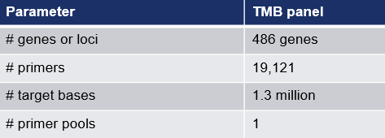
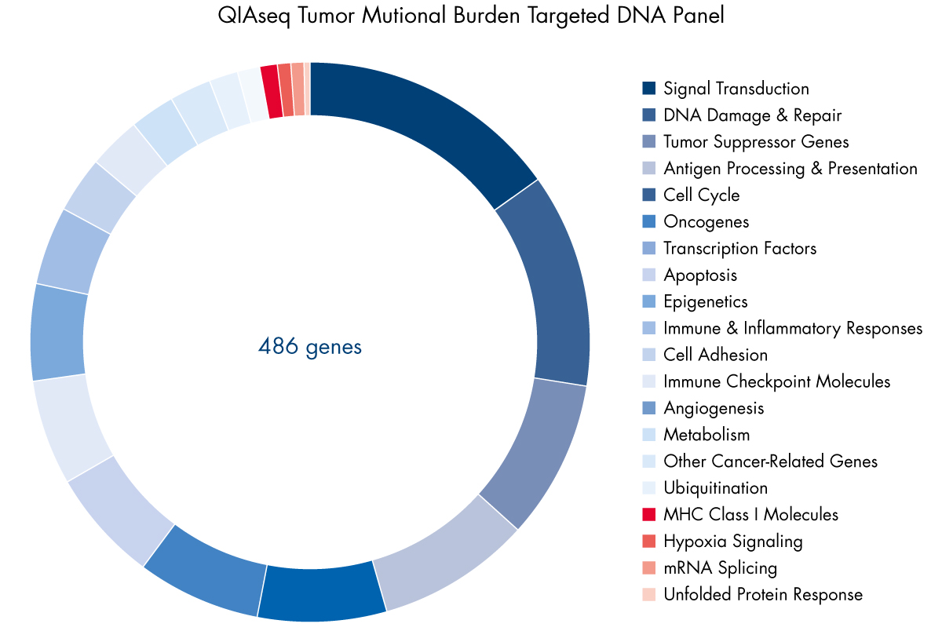
What is Tumor Mutation Burden (TMB) – Why Is It Important? [NOT Multimodal 2019]
Tumor Mutational Burden (TMB) is an emerging, quantitative indicator for predicting response to novel immune checkpoint inhibitors across a wide spectrum of tumor types. TMB measures the total number of non-synonymous, somatic mutations identified per megabase of the genome coding area (a megabase is 1,000,000 DNA basepairs).
Tumors with high TMB likely harbor neoantigens and may respond more favorably to immune checkpoint inhibitors
Out of 1,000,000 sequenced bases, how many mutations do you see?
Iñigo Martincorena, Peter J. Campbell; Science 25 Sep 2015: Vol. 349, Issue 6255, pp. 1483-1489

Slide 44
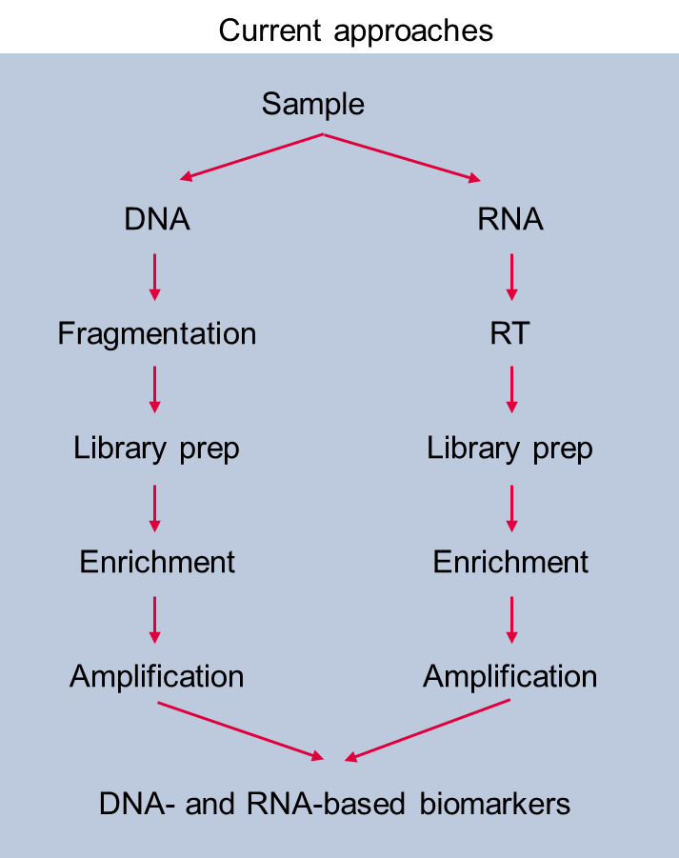
Need: A single low-input workflow to profile both DNA and RNA to reduce time and cost
Ideal approach
QIAseq Multimodal workflow
Sample
Tissue
Total nucleic acid
Total nucleic acids
Simultaneous library prep
Fragmentation
DNA variants and RNA fusions
RNA polishing
Benefits
High sensitivity DNA and RNA variant detection, including novel fusions
A consolidated workflow reduces overall turnaround time, cost for reagents, consumables and resources
Single sample requirement, with as low as 10 ng input, ensures sample availability for future/additional analysis
RT and library prep
Simultaneous
DNA and RNA enrichment
Amplification
Sequencing
Up to 66% reduction in turnaround time. Reducing two workflows into one

Slide 45
QIAseq Mulitmodal Overview & Workflow
Sample
extraction
Panels
(SPE)
Indexes
(UMIs, UDIs)
Custom builder
Analysis CLC
Genomics Workbench
Analysis
GeneGlobe
Interpretation
QCI-I
Sample collection and stabilization
Nucleic acid isolation
NGS library prep
Sequencing
Data analysis and interpretation
FFPE, Blood
Panels
Leukemia, Lung, Sarcoma, Custom
Illumina sequencers
QIAGEN CLC Genomics Workbench
QIAGEN Clinical Insight – Interpret for QIAseq
Total nucleic acid isolated from blood, FFPE samples or cells/tissues
Targeted DNA and RNA libraries prepared using a consolidated workflow
Data analysis and interpretation with either the QIAseq analysis pipeline or QIAGEN CLC Genomics Workbench

Slide 46
The power of one
QIAseq Multimodal Panels workflow – from Sample to Insight
Extract more information from one total nucleic acid input
1
Minimize sampling bias by deriving DNA and RNA signatures from the same population of molecules
Sample input
Profile both genomic and transcript-level variants from as low as 10 ng sample input
Compatible with samples of limited availability
QIAseq Multimodal Panels are intended for molecular biology applications. These products are not intended for the diagnosis, prevention or treatment of a disease.

Slide 47
The power of one
QIAseq Multimodal Panels workflow – from Sample to Insight
Single primer extension (SPE)
Minimize primer drop outs
High uniformity maximizes sequencing bandwidth
Up to 20,000 target amplicons per enrichment
1
Unique molecular indices (UMIs)
Confidently call variants at <1% VAF (as low as 0.5%)
Recognize true variants, eliminate artifacts
Enrichment workflow
For simultaneous
DNA and RNA enrichment
and sequencing
Unique dual indices (UDIs)
Overcome the index hopping issue, especially for high sensitivity applications
Streamlined workflow, reduced overall cost and reduced hands-on time (down to 3.5 h)
QIAseq Multimodal Panels are intended for molecular biology applications. These products are not intended for the diagnosis, prevention or treatment of a disease.

Slide 48
The power of one
QIAseq Multimodal Panels workflow – from Sample to Insight
1
Reduce overall turnaround time for DNA and RNA enrichment from 2–3 days down to a single day
Workday
Go from sample to sequencing in 9 h
QIAseq Multimodal Panels are intended for molecular biology applications. These products are not intended for the diagnosis, prevention or treatment of a disease.

Slide 49
Gain more insights while streamlining your workflows
Consolidation of assays/panels for biomarker detection
1
Single nucleotide variant (SNVs)
Insertions and deletions (InDels)
Copy number variants (CNVs)
Tumor mutational burden (TMB)
Microsatellite instability (MSI)
Methylation
Known and novel fusions
Gene expression
Exon skipping
2
3
Can be called with CURRENT multimodal panels
4
5
6
7
8
9
Notes:
Point to light blue – DNA, dark blue - RNA

Slide 50
Agenda
Background
QIAseq Multimodal Panel introduction
QIAseq Multimodal Panels: Performance
Summary

Slide 51
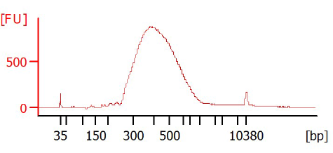
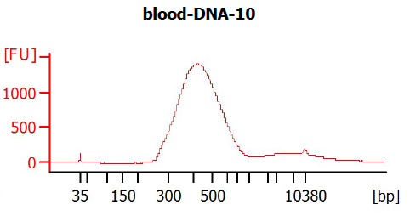
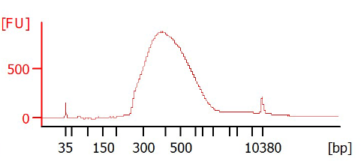
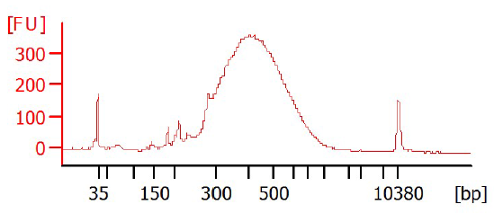
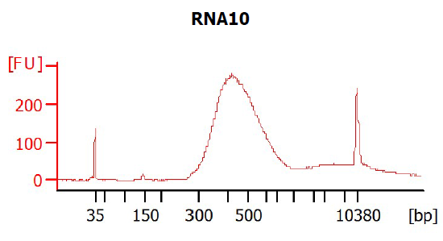
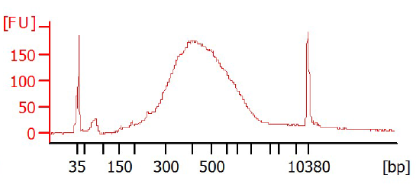
Total nucleic acid isolation or separate DNA and RNA isolation
Total nucleic acid selection wheel
Cells, tissue, FFPE and whole blood
Isolation protocols
Total nucleic acid
Supplementary protocols (DNA + RNA eluates into a single tube)
Separate DNA and RNA eluates
Cells and tissue: AllPrep DNA/RNA Mini Kit
FFPE tissue: AllPrep DNA/RNA FFPE Kit
Whole blood: PAXgene Blood kits
Multimodal library preparation handbook
Multimodal library preparation website
Weblink to “Total NA selection wheel”
Starting material
DNA: 10 ng to 40 ng
RNA: 10 ng to 250 ng
Total nucleic acid: 10 ng to 40 ng DNA
Blood
FFPE
AllPrep
DNA/RNA
FFPE Mini Kit
Cells
Tissues
Kit-specific product page
Link to supplementary protocols
FFPE
Blood
Cells
DNA
Libraries
RNA
Libraries

Slide 52
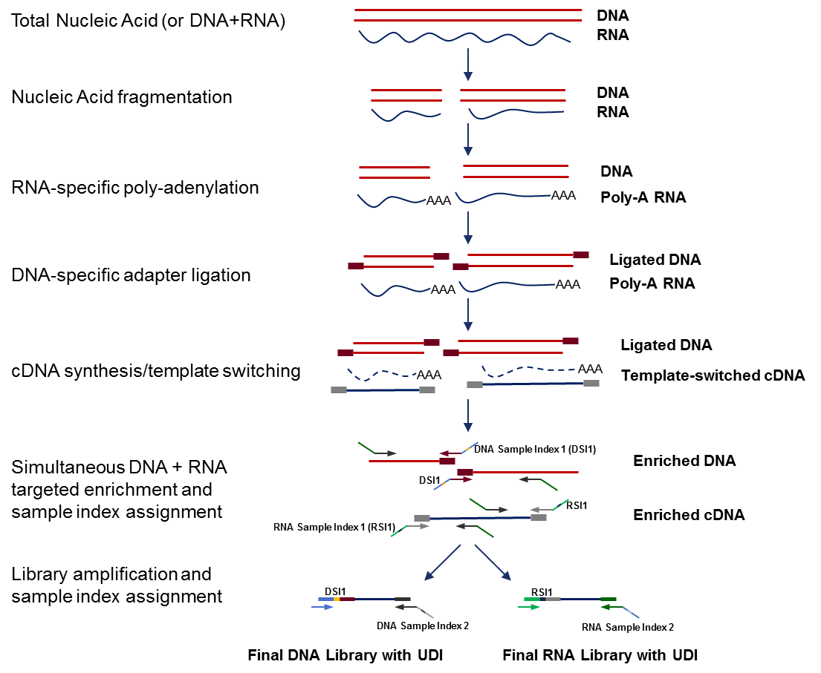
QIAseq Multimodal: Consolidated DNA and RNA library construction
Panels for consolidated targeted DNA and RNA enrichment
Lung Cancer, Sarcoma, Leukemia and custom
Total nucleic acids (DNA and RNA)
DNA RNA
Sample types
FFPE, whole blood, cells and tissues
Starting material
DNA: 10 ng to 40 ng
RNA: 10 ng to 250 ng
Total nucleic acid: 10 ng to 40 ng DNA
Unique dual indexing (UDIs)
Dried indices in cuttable plates
96 samples (192 libraries)
Total workflow time: 9–11 hours
Total hands-on time: 3.5 hours
Nucleic acid fragmentation
DNA RNA
RNA-specific polyadenylation
DNA Poly-A RNA
DNA-specific adapter ligation
Ligated DNA Poly-A RNA
Ligated DNA Template-switched cDNA
cDNA synthesis/template switching
Simultaneous DNA and RNA targeted enrichment and sample index assignment
Enriched DNA
Enriched RNA
Library amplification and sample index assignment
DNA: Somatic mutations, SNPs, InDels, CNVs
RNA: Fusions (known and novel), SNPs, InDels and gene expression
Final DNA library with UDI
Final RNA library with UDI

Slide 53
QIAseq Multimodal Panels: Library construction
Total nucleic acids (DNA and RNA)
DNA RNA
12 and 96 reaction kits
Integrated unique molecular indices (UMIs) for RNA and DNA
DNA: 12-base UMI
RNA: 10-base UMI
Unique dual indexing (UDIs)
Dried indices in cuttable plates
Set A: Index two sets of 48 samples, both for DNA and RNA libraries
Set B: Index two sets of 48 samples, both for DNA and RNA libraries
Nucleic acid fragmentation
DNA RNA
RNA-specific polyadenylation
DNA Poly-A RNA
DNA-specific adapter ligation
Ligated DNA Poly-A RNA
Ligated DNA Template-switched cDNA
A
Sample 1
B
cDNA synthesis/template switching
D
Sample 2
C
E
Sample 3
F
Simultaneous DNA and RNA targeted enrichment and sample index assignment
Enriched DNA
G
Sample 4
H
Enriched RNA
X
Sample 5
Y
Library amplification and sample index assignment
Z
Sample 6
W
Combinations are all unique, without any shared sample indices
Final DNA library with UDI
Final RNA library with UDI

Slide 54
QIAseq Multimodal: Consolidated DNA and RNA library construction
Total nucleic acids (DNA and RNA)
DNA RNA
How are DNA and RNA molecules fragmented?
DNA: Enzymatic fragmentation
RNA: Heat + molecular cation fragmentation
Nucleic acid fragmentation
DNA RNA
RNA-specific polyadenylation
DNA Poly-A RNA
Poly-adenylation creates a handle for reverse-transcription
Ligated DNA Poly-A RNA
Single-adapter containing a 12 bp unique molecular index (UMI)
DNA-specific adapter ligation
Why cDNA synthesis and template switching?
Selectively converts RNA into cDNA (UMI introduced)
Template switching ensures that a universal sequence is on both ends of the cDNA (UMI introduced)
Ligated DNA Template-switched cDNA
cDNA synthesis/template switching
Enriched DNA
Single primer extension (SPE) enrichment and first indexing
DNA: Somatic mutations, SNPs, InDels, CNVs
RNA: Fusions, SNPs, InDels and gene expression
Simultaneous DNA and RNA targeted enrichment and sample index assignment
Enriched RNA
Library amplification and sample index assignment
Library amplification and second indexing
Specific tuning of DNA and RNA library amplification
Optional qPCR to ensure optimal amplification
Final DNA library with UDI
Final RNA library with UDI

Slide 55
QIAseq SPE design for a known fusion detection
Example: Known fusion transcript whose breakpoint is:
The end of Exon 2, Gen X (blue) and
The beginning of Exon 6, Gene Y (red)
SPE is then designed, based on the known breakpoint of
Exon 2, Gene X and
Exon 6, Gene Y.
The breakpoint is covered from both side for better sensitivity
Exon 1
Exon 2
Exon 6
Exon 7
Exon 8
Primer
Primers
Exon 1
Exon 2
Exon 6

Slide 56
QIAseq SPE design for a novel fusion discovery
Design based on a Gene X (depicted by Exons 1, 2 and 3) – all exons and all transcripts as one side of fusion partner
In this example, designing against all exons and transcripts detected a novel fusion of:
<Exon 1, Gene X><Exon Y, Gene A>
<Exon 2, Gene X><Exon Z, Gene B>
Primer
Primers
Primers
Exon 1
Exon 2
Exon 3
Exon Y, Gene A
Exon Z, Gene B
Design based on a specific exon in a transcript of Gene X or a specific breakpoint for Gene X
In this example, designing against a specific exon detected a novel fusion of:
<Exon 2, Gene X><Exon Z, Gene B>
Primers
Exon 1
Exon 2
Exon 3
Exon Y, Gene A
Exon Z, Gene B

Slide 57
Agenda
Background
QIAseq Multimodal Panels introduction
QIAseq Multimodal Panels: Performance
Summary

Slide 58
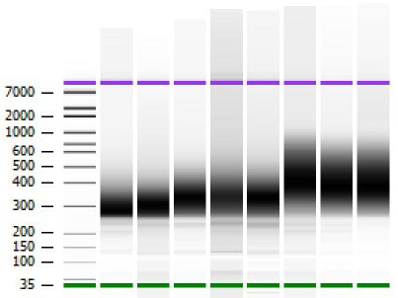
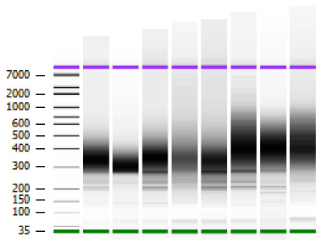
QIAseq Multimodal Panels: Robust performance with FFPE samples
QIAseq Multimodal Panels prepare robust targeted DNA and RNA libraries from FFPE samples
Experimental overview
Samples:
1–5: FFPE
6: Horizon HD200 Quantitative Multiplex Reference Standard FFPE (Horizon)
7: Seraseq FFPE Tumor Fusion Reference Material v2 (SeraCare)
8: HT 1080 cells
Isolation kit: QIAGEN supplementary protocol for isolation of total nucleic acid from FFPE samples
Library prep workflow: QIAseq Multimodal Panel (Lung Cancer)
Sequencing: Illumina
Data analysis: QIAseq Multimodal Data Analysis Pipeline
Bioanalyzer traces of libraries
1
2
3
4
5
6
7
8
Multimodal Targeted DNA Library
Multimodal Targeted RNA Library
QIAseq Multimodal Panels prepare robust libraries, even from difficult samples.

Slide 59
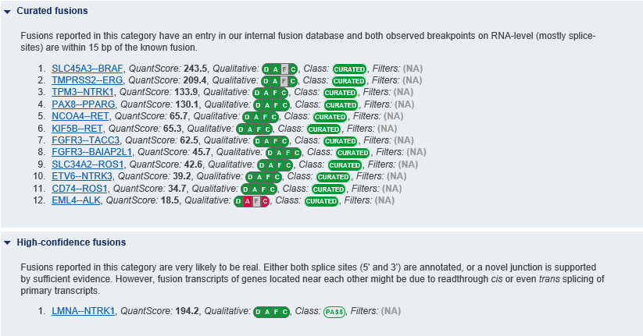
QIAseq Multimodal Panels: Robust performance with FFPE samples (cont.)
All DNA variants were called as expected, with sensitivity down to 1%
HD200 variant analysis
All RNA fusions were called as expected, including two exon skipping events
Seraseq fusion analysis
Chromosome | Gene | Variant | Expected frequency (%) | Experimental frequency (%)
7q34 | BRAF | V600E | 10.5 | 7.0
7p12 | EGFR | ΔE746–A750 | 2.0 | 1.0
7p12 | EGFR | L858R | 3.0 | 3.2
7p12 | EGFR | T790M | 1.0 | 1.0
7p12 | EGFR | G719S | 24.5 | 24.6
12p12.1 | KRAS | G13D | 15.0 | 17.5
12p12.1 | KRAS | G12D | 6.0 | 7.4
1p13.2 | NRAS | Q61K | 12.5 | 13.1
3q26.3 | PIK3CA | H1047R | 17.5 | 17.1

Slide 60
QIAseq Multimodal: Seraseq Myeloid Mutation DNA Mix & Myeloid Fusion RNA Mix
Samples:
40 ng Seraseq Myeloid Mutation DNA Mix (SeraCare)
100 ng Seraseq Myeloid Fusion RNA Mix (SeraCare)
Library prep workflow:
QIAseq Multimodal Panel (DNA Comprehensive Cancer + RNA Human Oncology)
QIAseq Targeted DNA Panel (DNA Comprehensive Cancer)
QIAseq RNAscan Panel (RNA Human Oncology)
Sequencing: Illumina
Data analysis:
QIAseq Multimodal Data Analysis Pipeline
QIAseq Targeted DNA Panel Analysis Pipeline
QIAseq Targeted RNAscan Panel Analysis Pipeline
Data analysis metrics
Primer specificity, primer uniformity
Variant calling, indel calling, fusion analysis
Workflows | DNA | RNA
QIAseq Multimodal Panel
QIAseq Targeted DNA Panel
QIAseq Targeted RNAscan Panel

Slide 61
QIAseq Multimodal: Seraseq Myeloid Mutation DNA Mix & Myeloid Fusion RNA Mix (cont.)
QIAseq Multimodal and Targeted DNA exhibit highly similar DNA variant calling
QIAseq Multimodal and Targeted RNAscan exhibit highly similar RNA variant calling
DNA variant analysis
RNA variant analysis
Gene ID | Variant type | Expected VAF | QIAseq Targeted DNA VAF | QIAseq Multimodal VAF
ABL1 | SNV | 10% | 12% | 14%
ASXL1 | Deletion | 10% | 7% | 6%
ASXL1 | Insertion | 10% | 11% | 9%
BRAF | SNV | 10% | 15% | 16%
CEBPA | Insertion | 15% | 9% | 11%
CEBPA | Insertion | 15% | 11% | 11%
CSF3R | SNV | 5% | 9% | 8%
FLT3 | SNV | 10% | 11% | 11%
IDH1 | SNV | 5% | 7% | 10%
JAK2 | SNV | 5% | 7% | 8%
JAK2 | Deletion | 10% | 13% | 8%
MPL | SNV | 5% | 7% | 10%
MYD88 | SNV | 10% | 14% | 16%
SF3B1 | SNV | 5% | 8% | 8%
SF3B1 | SNV | 5% | 8% | 6%
SRSF2 | Deletion | 5% | 3% | 3%
U2AF1 | SNV | 10% | 13% | 13%
Gene ID | 5' Fusion partner | 3' Fusion partner | QIAseq RNAscan called? (Y or N) | QIAseq Multimodal called? (Y or N)
BCR-ABL1 | NC_000022.11:23290413 | NC_000009.12:130854064 | Y | Y
ETV6-ABL1 (transcript 1) | NC_000012.12:11869969 | NC_000009.12:130854064 | Y | Y
ETV6-ABL1 (transcript 2) | NC_000012.12:11853561 | NC_000009.12:130854064 | Y | Y
FIPIL1-PDGRFA | NC_000004.12:53414722 | NC_000004.12:54274885 | Y | Y
MYST3-CREBBP | NC_000008.11:41937256 | NC_000016.10:3851009 | Y | Y
PCM1-JAK2 | NC_000008.11:17972687 | NC_000009.12:5069925 | Y | Y
RUNX1-RUNX1T1 | NC_000021.9:34859474 | NC_000008.11:92017363 | Y | Y
TCF3-PBX1 | NC_000019.10:1619111 | NC_000001.11:164792494 | Y | Y

Slide 62
QIAseq Multimodal Panel primers: Excellent specificity and uniformity
QIAseq Multimodal Panel’s primer performance matches that of QIAseq Targeted DNA Panel
Panels tested QIAseq Multimodal Panels
Panel | Associated product | Panel size (bases)
Actionable Solid Tumor | QIAseq Targeted DNA | 15,160
Comprehensive Cancer | QIAseq Targeted DNA | 836,670
Myeloid Neoplasms | QIAseq Targeted DNA | 436,672
Lung Cancer | QIAseq Multimodal | 318,059
Sarcoma | QIAseq Multimodal | 836,408
Leukemia | QIAseq Multimodal | 464,787
Primer specificity (%)
QIAseq Targeted DNA vs. QIAseq Multimodal Panels: Uniformity and specificity
Uniformity (0.2X mean base UMI, %)
Primer specificity (%)
Uniformity (0.2X mean base UMI, %)

Slide 63
Agenda
Background
QIAseq Multimodal Panels introduction
QIAseq Multimodal Panels: Performance
Summary

Slide 64
QIAseq Multimodal Panels: Consolidated targeted DNA and RNA library prep
Simultaneous preparation of targeted DNA and RNA libraries for robust detection of DNA and RNA variants of interest
What is QIAseq Multimodal?
Starting with total nucleic acids or separate DNA and RNA eluates, QIAseq Multimodal provides all reagents to simultaneously enrich for DNA and RNA regions of interest
Consolidates workflows, resulting in sample, time and money savings
What is the starting material?
10–40 ng (DNA) and 10–250 ng (RNA)
FFPE, whole blood, cells and tissues
How long does the workflow take?
9–11 hours (3.5 hours hands-on time)
What panels are available?
Cataloged panels: Lung Cancer, Sarcoma and Leukemia
Custom
What type of sample indices are available?
Unique dual indices (UDIs)
What data analysis options are available?
GeneGlobe Data Analysis Center and CLC Genomics Workflow
What data interpretation options are available?
Ingenuity Variant Analysis (IVA) tool or QIAGEN Clinical Insight Interpret (QCI-I)

Slide 65
Steven.Bass@qagen.com www.qiagen.com
Trademarks: QIAGEN®, Sample to Insight®, AllPrep®, Ingenuity®, GeneGlobe®, PAXgene®, QCI®, QIAseq® (QIAGEN Group); Horizon™ (Horizon Discovery Limited); Illumina® (Illumina, Inc.); SeraCare®, Seraseq® (Seracare Life Sciences, Inc.). Registered names, trademarks, etc. used in this document, even when not specifically marked as such, are not to be considered unprotected by law. PROM-15554-001 © 2019, QIAGEN, all rights reserved.

Slide 66
Current and Next Generation Technologies for Detection of Methyl Markers in Liquid Biopsy
Notes:
Welcome….
Epigenetic alterations are increasingly gaining traction in cancer research as new biomarkers for treatment decision or as therapeutic targets in precision medicine.
In our todays presentation I would like to discuss the value of DNA methylation analysis by NGS approaches and pyrosequencing

Slide 67
Epigenetics
Genetic alterations alone cannot fully explain the gene expression or cellular function changes during oncogenesis
Epigenetic mechanisms, influencing the gene activity without changing the DNA sequence, add-on to the variability in cancer cells
DNA methylation (5-mC)
DNA hydroxymethylation (5-hmC)
Histone modification
Chromatin remodeling
Non-coding RNAs, miRNA, small RNAs
Notes:
Genetic alterations do not sufficiently explain to full extent, the gene expression or cellular function changes that are observable during cancerogenesis.
Epigenetic mechanisms, influencing the gene activity without changing the DNA sequence, are observable to great extent in cancer and add-on to the variability in cancer cells. There are various epigenetic mechanisms.
DNA methylation occurs at cytosines resulting in 5-methylcytosine (5-mC), predominantly in the CpG dinucleotide context and is a key epigenetic regulator of embryogenesis and stem-cell differentiation in mammals.
Hydroxymethylation, the modification of a cytosine with a 5-hydroxymethyl group is considered an intermediate step in the process of active demethylation of 5-methylcytosine (5-mC), caused by the oxidation of 5-mC as a result of the TET (ten eleven translocation) family of enzymes, TET1, TET2, and TET3
Other epigenetic mechanisms are histone modification or chromatic remodeling as well as non-coding RNAs like miRNAs or other small RNAs.
Focus of this presentation is on DNA methylation analysis.

Slide 68
DNA methylation events in cancer
N
H
2
N
O
C
H
Hypomethylation
3
Hypermethylation
N
5-Methylcytosine
Reduction in methylated cytosines – active state of chromatin
Activation of cancer germline genes that are normally silenced
Increased transcriptional activity
Less compact chromatin structure may lead to genomic instability
Increase in methylated cytosines – repressed state of chromatin
Tumor suppressor gene silencing when regulatory sequences such as enhancer or promoter regions are affected
Change in expression of transcript isoforms when alternative promoters are affected
Pfeifer, G. (2018) Defining Driver DNA Methylation Changes in Human Cancer, Int. J. Mol. Sci. 2018, 19, 1166.
Notes:
Specificity of methylation patterns for different tissue types, differentiation status and disease states – promising biomarker
Stability in circulating cell-free DNA – promising liquid biopsy biomarker
Reversibility of methylation status – potential target for epigenetic therapies

Slide 69
Agenda
Epigenetics, DNA methylation and cancer research
Considerations in sample preparation by bisulfite conversion
A Liquid Biopsy Compatible solution for detection of Methyl markers in NGS
Pyrosequencing – biomarker validation for clinical research
Summary

Slide 70
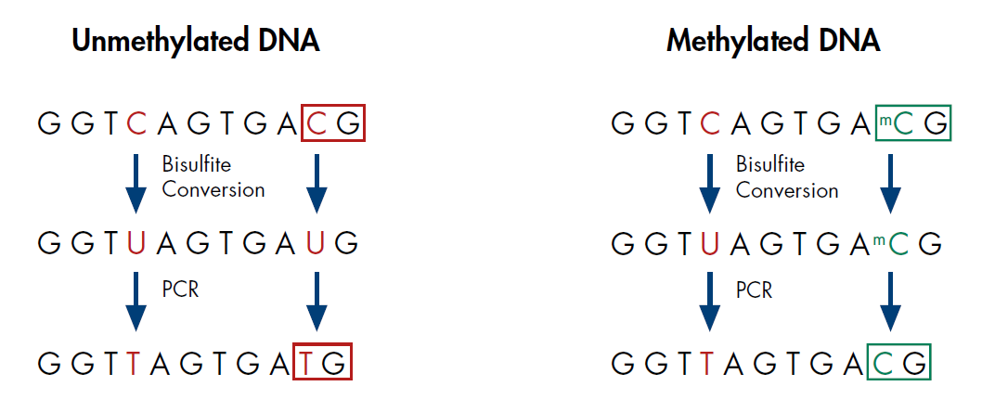
Bisulfite conversion – a fundamental step in methylation analysis
A technique to easily distinguish between methylated and unmethylated cytosines
Unmethylated DNA
Methylated DNA
Only unmethylated cytosines are converted to uracil and subsequently to thymine during PCR
Methylated cytosines are unaffected by the bisulfite reaction
Methylated and unmethylated cytosines can be detected by comparing bisulfite converted DNA to original untreated genomic DNA
Notes:
Exposing DNA to bisulfite rapidly leads to the deamination of unmethylated cytosines which are converted to 6-sulfonyluracil. At high pH, 6-sulfonyluracil is desulfonated to uracil, which ultimately after amplification will translate into thymidine, while methylated cytosines will not be converted. Comparing this converted DNA to the original unconverted sequence enables detailed evaluation of the location and abundance of methylated sites.
If the question arises: bisulfite conversion does not distinguish between 5-methylcytosine (5mC) and 5 –hydroxymethylcytosine (5-hmC)

Slide 71
Challenges of bisulfite conversion
DNA integrity
Completeness of conversion
Yield and concentration of bsDNA
Chemical conversion is done in high bisulfite salt concentrations at a high temperature and a low pH
These harsh conditions often lead to a high degree of DNA fragmentation and subsequent loss of DNA during purification
Incomplete conversion of unmethylated cytosines leads to false positive methylation results
Complete denaturation of the DNA is necessary for efficient bisulfite conversion
An optimal pH is needed for complete conversion of cytosine to uracil
DNA loss occurs during bisulfite treatment
Reliable downstream analysis requires:
Sufficient amount of intact bsDNA
Highly concentrated bsDNA

Slide 72
Agenda
Epigenetics, DNA methylation and cancer research
Considerations in sample preparation by bisulfite conversion
A Liquid Biopsy Compatible solution for detection of Methyl markers in NGS
Pyrosequencing – biomarker validation for clinical research
Summary

Slide 73
DNA methylation analysis technologies
Whole Genome
Reduced Genome
Focus Regions
Individual CpG Sites
Whole genome bisulfite sequencing
Highest genome coverage
For discovery studies
Low number of samples
Requires high sequencing capacity
DNA methylation microarray
Significant amount of CpG sites covered (but known loci only)
High sample input needed
Reduced representation bisulfite sequencing (RRBS)
Cost-effective
Enriches for CpG rich regions of the genome
Targeted DNA methylation sequencing
Focus on specific areas-of- interest enables:
High coverage in sequencing (500–1000X higher)
High sample throughput possible
High number of CpG sites
Assessment of disease-related sites and biomarker validation
Pyrosequencing
Quantitative analysis of individual CpG sites for clinical research
Low number of samples
Quantification of methylation status
Notes:
Whole-genome bisulfite sequencing (WGBS) and reduced representation bisulfite sequencing (RRBS) are widely used for measuring DNA methylation levels on a genome-wide scale. WGBS provides highest genome coverage but requires high sequencing capacitiy (therefore high cost) and usually only applicable for a low number of samples. Usually used for biomarker discovery studies.
RRBS only interrogates 6–12% of the CpGs in the human genome
Methylation microarray: can usually interrogate about 850,000 methylation sites. Lower cost as WGBS but known methylation sites only and requires quite high sample input: 250ng
Reduced representation bisulfite sequencing (RRBS) is an efficient and high-throughput technique for analyzing the genome-wide methylation profiles on a single nucleotide level. It combines restriction enzymes and bisulfite sequencing to enrich for areas of the genome with a high CpG content.
Targeted DNA Methylation sequencing is an appropriate method for focused region analysis in disease-related research or biomarker validation studies. Due to the focused approach, it allows a high sample throughput and high coverage in sequencing for increased sensitivity. In our QIAseq Targeted Methyl-seq panels a unique C site is covered by 1-2 primers, for CpG Islands ~8 CpG/ per primer e.g. for 100 primer panel that would be ~ 800 CpGs
Methylation-specific PCR is a method for analyzing a selected set of known genes.
Pyrosequencing is most appropriate for analysis of individual CpG sites. The quantitive aspect of pyrosequencing makes it a highly appropriate method for clinical research applications.

Slide 74
Whole methylome analysis
QIAseq Methyl Library Kit
Single-day, single-tube protocol allowing conversion of bisulfite-treated DNA to NGS library in just a few steps
Ultra-efficient library prep which minimizes sample loss
Full integration with CLC Genomics Workbench secondary data analysis
Specially optimized protocols for fragmented DNA, cell-free DNA and FFPE samples
Allows DNA inputs as low as 100 pg
Suitable for reduced representation bisulfite sequencing (RRBS)
Notes:
QIAseq™ Methyl Library Kit uses a single-day, single-tube protocol allowing conversion of bisulfite-treated DNA to NGS library in just a few steps
It enables ultra-efficient library prep which minimizes sample loss, is fully integreated with CLC Genomics Workbench secondary data analysis and uses a specially optimized chemistry for fragmented DNA, cell-free DNA and FFPE samples. DNA inputs can be as low as 100 pg
QIAseq Methyl can process also fragmented DNA using dedicated protocols for bisulfite conversion and can be used we preenriched DNA either RRPBS or enriched Methylated region analysis using MBP
High percentage of mapped reads and accurate methylation calls with low-input circulating cell-free DNA. ccfDNA from three different healthy donors was isolated using the QIAamp® MinElute® ccfDNA Kit. Total eluates in the range of 8–10 ng were bisulfite- treated using DNA Protect and an optimized incubation cycle to ensure complete conversion and avoid further fragmentation. The complete bisulfite-treated DNA was used to generate libraries using the QIAseq Methyl Library Kit. Quality control of the libraries was performed by sequencing at low depth and analyzing the data using Bismark analysis pipeline and the Bisulfite Sequencing Plugin of the CLC Genomic Workbench. A High mapping rate was obtained with all ccfDNA eluates. B Accurate methylation calls, with 99% bisulfite conversion, were observed. Conversion efficiency can be taken from the methylation degree of C in CHH and CHG content which is published to be close to 0% in mammalian cells.
Note: Bismark is an open software used often in the community.
Note for speaker – objection handling:
In case of discussing about this publication (https://www.nature.com/articles/s41467-019-11713-9) showing a inacceptable performance of QIAseq Methyl library. This was performed with alpha field-test material and not with the final product. Process for adding a statement to this report is ongoing.
In contrast there is already successful work with this Kit,which was presented in Hematology congress
https://qiagen.my.salesforce.com/0691i0000035UH4

Slide 75
Whole genome bisulfite sequencing with DNA purified from FFPE samples
High percentage of mapped reads
Accurate methylation calls, with 99% bisulfite conversion independent of the FFPE DNA amount used in protocol
DNA was purified from rat FFPE tissue from spleen and kidney using the QIAamp DNA FFPE Tissue Kit
FFPE DNA (10 and 100 ng) were treated with EpiTect Fast chemistry and QIAseq Methyl chemistry as described in the QIAseq Methyl Library Kit handbook for FFPE DNA
Libraries were sequenced in MiSeq at low depth and data were analyzed using the Bisulfite Sequencing Plugin of the CLC Genomic Workbench
Notes:
DNA was purified from rat FFPE tissue from Spleen and Kindey using the QIAamp DNA FFPE Tissue Kit. 10 and 100 ng of FFPE-DNA was treated with EpiTect Fast chemistry and QIAseq Methyl chemistry as described in the QIASeq Methyl library kit Handbook for FFPE DNA. Libaries were sequenced in MiSeq® at low depth. Data were analyzed using the Bisulfite Sequencing Plugin of the CLC Genomic Workbench
A High mapping rate was obtained with all FFPE samples eluates. B Accurate methylation calls, with 99% bisulfite conversion, were observed independent of the FFPE-DNA amount used in protocol.
Notes:
A
The reads in pairs are those that are the relevant ones when paired-end sequencing is done.
Read in pairs are reads that are mapping to the reference genome with the right distance . The opposite broken pairs is an indicator for chimeric reads that might be generated during the ligation procedure. The broken pairs migh come from chrimeric molecules from different contigs from the same genome or form chimeric reads to unknown → mostly contaminating DNAs or reads shorter as the sequencing length which lead to read over the adapter sequences.
DIN is a quality number for DNA Integration ( quality) resulted by tape station analysis. Good qulaity is 7-9, 7-5 lower quality , <5 is low integrity and strongly fragmented DNA. The higher the quality the lower could be the input. You see here lower quality DNA input coming from FFPE samples, Still high mapping rates are achieved
B
The methylation degree of C in CHH and CHG is a good indicator of bisulfite conversion. CHH and CHG content is published to be close 0% in mammalian cells. In our data methylation degree is close to 0- therefore highly successful bisulfite conversion.

Slide 76
Whole methylome analysis of ccfDNA using the QIAseq Methyl Library Kit
High percentage of mapped reads with all ccfDNA eluates
Accurate methylation calls with 99% bisulfite conversion
ccfDNA from three different healthy donors was isolated using the QIAamp MinElute ccfDNA Kit
Total eluates in the range of 8–10 ng were bisulfite-treated using EpiTect Fast to ensure complete conversion and avoid further fragmentation
The complete bisulfite-treated DNA was used to generate libraries using the QIAseq Methyl Library Kit
Quality control of the libraries was performed by sequencing at low depth and analyzing the data using Bismark analysis pipeline and the Bisulfite Sequencing Plugin of the CLC Genomic Workbench
Notes:
QIAseq™ Methyl Library Kit uses a single-day, single-tube protocol allowing conversion of bisulfite-treated DNA to NGS library in just a few steps
It enables ultra-efficient library prep which minimizes sample loss, is fully integreated with CLC Genomics Workbench secondary data analysis and uses a specially optimized chemistry for fragmented DNA, cell-free DNA and FFPE samples. DNA inputs can be as low as 100 pg
QIAseq Methyl can process also fragmented DNA using dedicated protocols for bisulfite conversion and can be used we preenriched DNA either RRPBS or enriched Methylated region analysis using MBP
High percentage of mapped reads and accurate methylation calls with low-input circulating cell-free DNA. ccfDNA from three different healthy donors was isolated using the QIAamp® MinElute® ccfDNA Kit. Total eluates in the range of 8–10 ng were bisulfite- treated using DNA Protect and an optimized incubation cycle to ensure complete conversion and avoid further fragmentation. The complete bisulfite-treated DNA was used to generate libraries using the QIAseq Methyl Library Kit. Quality control of the libraries was performed by sequencing at low depth and analyzing the data using Bismark analysis pipeline and the Bisulfite Sequencing Plugin of the CLC Genomic Workbench. A High mapping rate was obtained with all ccfDNA eluates. B Accurate methylation calls, with 99% bisulfite conversion, were observed. Conversion efficiency can be taken from the methylation degree of C in CHH and CHG content which is published to be close to 0% in mammalian cells.
Note: Bismark is an open software used often in the community.
Note for speaker – objection handling:
In case of discussing about this publication (https://www.nature.com/articles/s41467-019-11713-9) showing a inacceptable performance of QIAseq Methyl library. This was performed with alpha field-test material and not with the final product. Process for adding a statement to this report is ongoing.
In contrast there is already successful work with this Kit,which was presented in Hematology congress
https://qiagen.my.salesforce.com/0691i0000035UH4

Slide 77
A Targeted Liquid Biopsy Compatible solution for detection of Methyl markers in NGS
QIAseq Targeted Methyl Panels & Workflow

Slide 78
Oncology Associated Methyl Panel Content
Colorectal Cancer Panel
RUNX3 | MDFI | WIF1
TP73 | EYA4 | GRASP
MAL | IRF4 | SLC16A7
CNRIP1 | IKZF1 | SOX21
TMEFF2 | DLX5 | COL4A2
SHOX2 | NPY | SPG20
MLH1 | NPTX2 | SOX1
RASSF1 | TFPI2 | THBS1
HLTF | IGFBP3 | FBN1
UNC5C | SDC2 | CMTM3
SNCA | CDKN2A | SOCS1
PDGFRA | MGMT | FOXF1
BMP3 | VIM | NDRG4
DKK2 | INA | NGFR
SFRP2 | FOXI2 | SEPT9'
FGF5 | ALX4 | SSTR2
NEUROG1 | IGF2 | CACNA1G
APC | IRAK3 | DCC
CDO1 | ST8SIA1 | ZSCAN18
EYA2 | BCAT1 | RASSF2
ESX1 | SLC6A15 | ARMCX1
Breast Cancer Panel
BCAP31 | RUNX3 | TIMP3 | TM6SF1
CDKN2A | RASGRF2 | COL6A2 | AKT1
DAB2IP | SCGB3A1 | TFF1 | BMP4
PAX5 | CDKL2 | CPXM1 | ESR2
PSAT1 | FGF2 | FAM110A | OTX2
cg23495581 | KDR | BIN1 | SERPINA5
SFRP1 | PDGFRA | ITGA4 | ARHGEF7
AKR1B1 | PITX2 | NEUROD1 | DACH1
CAV2 | SFRP2 | POMC | ALX1
FZD9 | B3GNT5 | TMEFF2 | CCND2
HDAC9 | GHSR | JAK3 | IGF1
HOXA10 | MLH1 | BRCA1 | CST6
HOXA11 | MME | GAS7 | DKK3
HOXA4 | RASSF1 | HOXB4 | FGF4
IGFBP3 | RBP1 | RARA | GSTP1
BMP6 | ST3GAL6 | CDH13 | HRAS
CDKN1A | Sept9' | FOXC2 | P2RX3
ESR1 | BCR | MAPK3 | PAK1
HIST1H3C | INA | PALB2 | PAX6
IRF4 | MGMT | GREM1 | THY1
APC | AKT3 | RASGRF1 | WT1
DNM3 | FABP3 | SHF | GPX7
 |  | PTGS2 | PIK3CD
General Immuno-Oncology
CD58 | CD86 | CD274
CD2 | CD80 | PRF1
IL10 | cg12069309 | INA
TNFSF18 | CCR5 | IL2RA
TNFRSF18 | HHLA2 | PTPRCAP
CD247 | IL12A | IL18
TNFSF4 | RASSF1 | CD3D
TNFRSF4 | CD86 | CXCR5
TNFRSF14 | SEMA3B | CXCR5
IL12RB2 | CXCL9 | NCR3LG1
STAT1 | CXCL10 | LAG3
ICOS | IL2 | IFNG
ZAP70 | CXCL11 | IFNG
PDCD1 | HAVCR2 | CD27
ZAP70 | IL4 | CD4
CTLA4 | IL12B | GZMB
CD8A | IL13 | CD276
CD28 | GZMA | CD19
ZAP70 | IL17A | LGALS9
RASSF1 | TNF | CCL5
CXCR6 | IDO1 | TNFSF9
BTLA | PDCD1LG2 | ICAM1
KLHL6 | CCL19 | TNFRSF9
FOXP3 | ICOSLG | CD70
 | CD40 | CD79A
Coming in 2020: T-Cell Infiltration/Cell type Differentiation
An immuno-Oncology focused panel that combines Immuno-Oncology Markers, along with cell type markers to determine percentage of cell type for solid tissue samples

Slide 79
Single Day to Sequencer: QIAseq Targeted Methylation sequencing workflow
DNA - bisulfite conversion:
EpiTect Fast
DNA end-repair
: methylated C
: non methlated C
U C U C U
Ligation of first IL-Me N7# index with UMI
Target enrichment by single primer extension
X
U C U C U
7,5 h
UMI
U C U C U
6 h
5´
Library amplification and sample indexing with and IL-S5#-index primer
U C U C U
GSP
FP
Repeated sampling
UMI: Unique melecular index
FP: Forward primer
GSP: gene specific primer
UP: universal primer
SIP: Sample index primer
5´
T C T C T
UP
SIP
Library

Slide 80
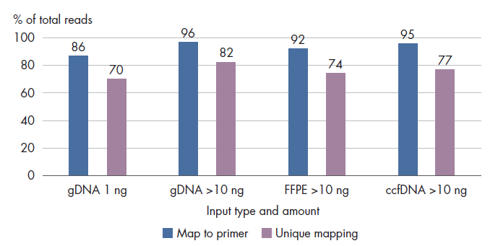
High Performance from Tissue and Liquid Biopsy: Showing 1-10ng of input
QIAseq Targeted Methyl Panel: High mapping efficiency even at 1ng of input
gDNA was run at both 1 and 10ng
FFPE was run at 10ng
ccfDNA was run at 10ng
Results show high mapping on primer and unique reads even from 10ng inputs

Slide 81
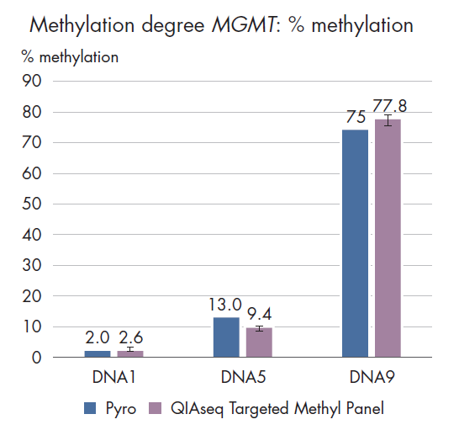
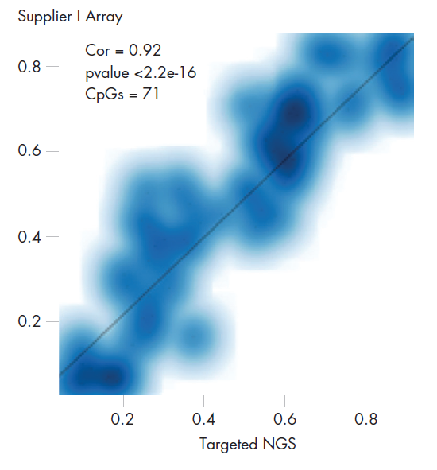
Much Lower input amounts with High Correlation to established methods
Despite 1/5th the input, QIAseq Targeted Methyl shows 92% Correlation to EPIC Array
QIAseq Targeted Methyl Has high correlation to Pyromark Assays
To test methylation status of FFPE DNA, the QIAseq Targeted Methyl Panel was used with 40 ng input FFPE DNA. The panel consisted of 93 primers.
The evaluated methylation degree of 7 CpG sites of the MGMT gene highly correlates to the methylation degree that was previously validated with Pyrosequencing.
QIAseq Targeted Methyl Panel was used with 40 ng input gDNA from hepatocytes.
Panel consisted of 102 primers, covering 71 CpGs.
Showed High Correlation to Supplier I microarray, 92%
81

Slide 82
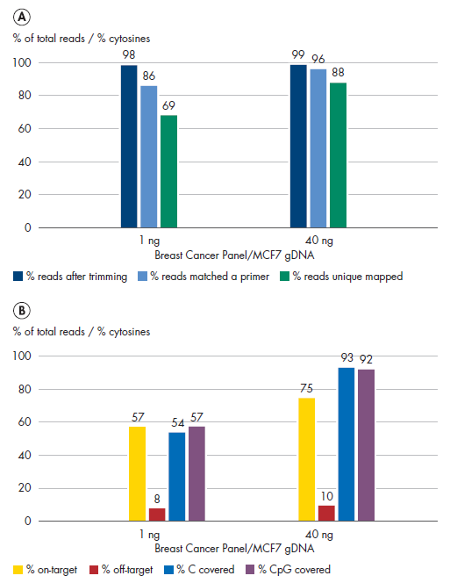
QIAseq Targeted Methyl Panel: Human Breast Cancer Panel
High performance at Ultra Low input levels Leads to High Quality Data
To evaluate library characteristics of the Human Breast Cancer Panel (cat. no. MHS-001Z), 1 ng and 40 ng gDNA were used to generate libraries. Libraries were sequenced on MiSeq, resulting in high mapping rates and high numbers of CpGs covered. Library quality is high even with the lowest possible input used for bisulfite conversion with EpiTect Fast chemistry.

Slide 83
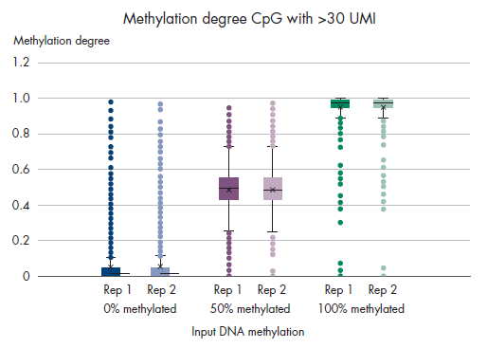
QIAseq Targeted Methyl Panel: methylation degree reproducibility
QIAseq Targeted Methyl Panel: High methylation reproducibility from control samples used as a benchmarking tool
40 ng control DNA with 0%, 50% and 100% methylation were processed using the QIAseq Targeted Methyl Panel,
Panel consisted of 749 primers
Samples were sequenced on MiSeq and methylation degree of CpG covered by >30 UMI was evaluated

Slide 84
Generate High Quality Libraries from ccfDNA with different Panel Sizes
To evaluate library characteristics, ccfDNA was purified using QIAamp chemistry and subsequently bisulfite treated using EpiTect Fast chemistry.
10 ng ccfDNA was processed using 3 different panels. The QIAseq Targeted Methyl Panel workflow generated high quality libraries that resulted in high percentages of unique reads

Slide 85
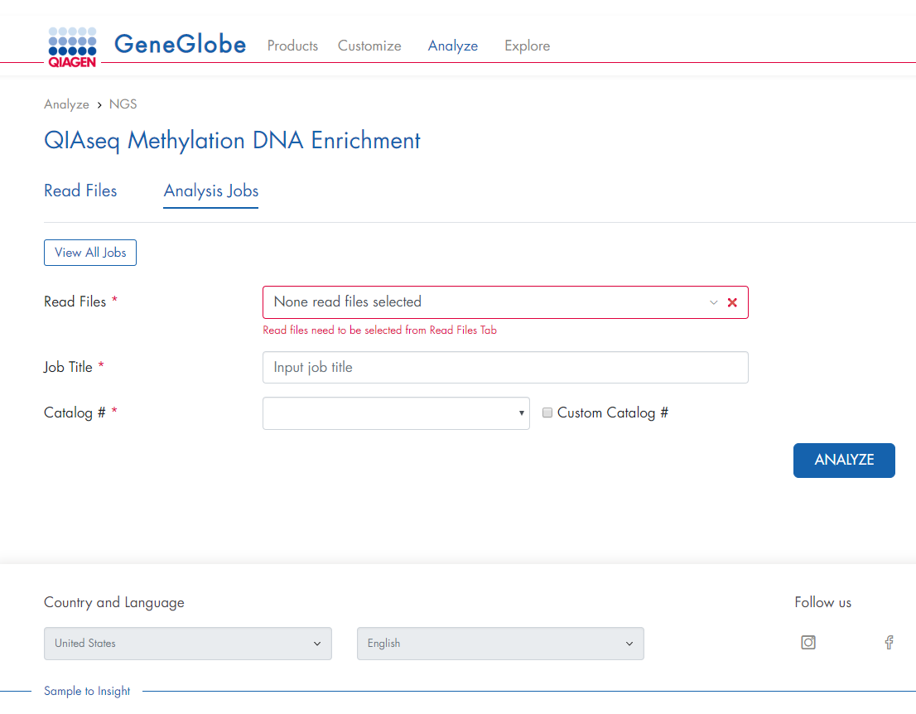
Cloud Based Analysis is available through GeneGlobe
Analyze your data wherever you are
Upload run files directly to the Cloud
Custom Catalog numbers are provided for user defined content
Output is generated directly to your QIAGEN.com account an can be downloaded for tertiary analysis

Slide 86
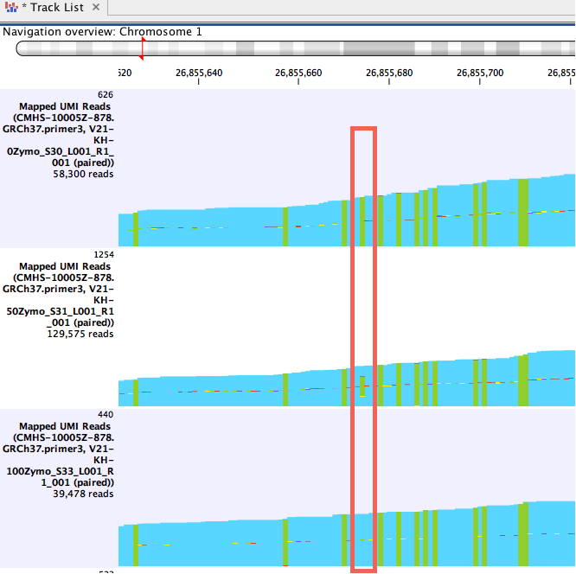
Use CLC Analysis to Visualize your data
CLC Analysis Can be visualized to see the number of differentially methylated CpGs along the chromosome
: Case/Control (aka tumor/normal) Comparisons
CLC Analysis showing mismatches in a read mapping coverage graph.
Screenshot right: green bars represent C -> T mismatches in the mapping. Within the red rectangle, the top sample has a CpG that is fully unmethylated, the middle sample is 50% methylated, and the bottom sample is fully methylated.
How do I get CLC Methylation analysis??
Download your Trial Information

Slide 87
Agenda
Epigenetics, DNA methylation and cancer research
Considerations in sample preparation by bisulfite conversion
A Liquid Biopsy Compatible solution for detection of Methyl markers in NGS
Pyrosequencing – biomarker validation for clinical research
Summary

Slide 88
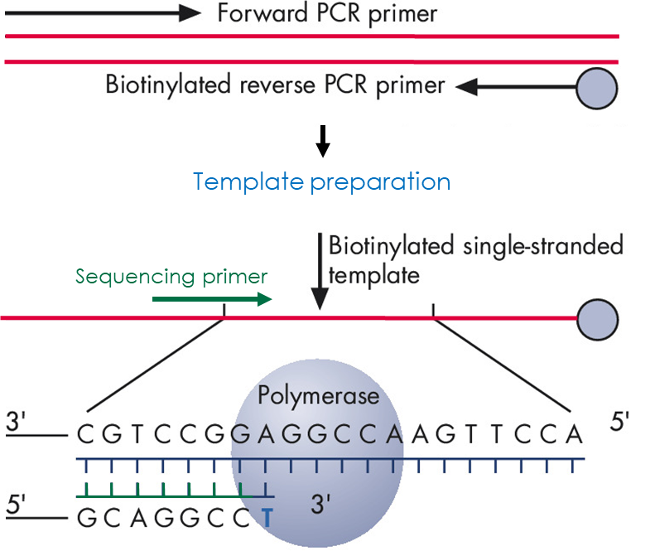
Pyrosequencing – the technology for quantitative methylation analysis
Based on the sequencing-by-synthesis principle
Starts with bisulfite-treated DNA
The target region is amplified by PCR using a biotinylated primer
ssDNA strand attached to streptavidin is generated
Annealing of sequencing primer starts Pyrosequencing reaction
Enzyme cascade generates a light signal upon incorporation of nucleotides
Only one nucleotide (dNTP) is added at a time
Light signals are proportional to the amount of nucleotides incorporated
Intensity of the signals are used for quantification of sequencing results
Notes:
Sequencing by synthesis is also used by Illumina or the GeneReader, however the nucleotides used in NGS are fluorescently labeled. Pyrosequencing detects light which is produced when a nucleotide is incorporated. The advantage is that the light produced is relative to the number of nucleotides incorporated, making it a quantitative technology.
In a first step the DNA is converted through bisulfite treatment and the targeted region is amplified by PCR.
The PCR fragment usually has a size of <200bps and one of the primers is biotinylated enabling it to bind to Streptavidin.
The dsPCR fragment is added to a well in the PyroMark where the instrument will denature the fragment and the ssDNA strand with is biotinylated will bind to Streptavidin beads.
Now the sequencing primer can be added (by the instrument or manually) and anneals to the ssDNA template bound to a bead.
Nucleotides are dispensed by the instrument into the reaction.
The instrument records which nucleotide is dispensed and then measures the light produced within each well.
Dispensing the nucleotides and detecting the light signals in a 48 well discs takes less than 1 minute.
A complete run typically takes less than 1 hour.​
​

Slide 89
MGMT methylation analysis with pyrosequencing an example in cancer research
Pyrosequencing is used in clinical research to detect differential methylation patterns which may effect therapy decisions in the future
One such example is the promoter of the MGMT gene; studies show that the level of methylation of the MGMT promoter determines the response to alkylating agent chemotherapy
Epigenetic silencing of the MGMT gene by promoter methylation in glioma cells compromises the DNA repair mechanism and increases chemosensitivity, whereas low level of methylation in the target site shows minimal response to such treatment
Notes:
A typical Pyrogram for MGMT analysis is shown here. The CpG sites are highlighted in blue and the bisulfite conversion control in yellow. The % of methylation for each CpG is directly shown after the run.
It was found that the response to alkylating agent chemotherapy/Temozolomide or its brand name Temodal is altered depending on the methylation state of the promoter of the MGMT gene.
You can find some more information in this review:
Reference: Wick W, Weller M, van den Bent M, et al: MGMT testing-the challenges for biomarker-based glioma treatment. Nat Rev Neurol 2014;10:372-385​
We also have a blog post regarding the findings from Quillien et al.:
http://oncologysolutions.qiagen.com/2016/12/21/pyrosequencing-mgmt-promoter-methylation-analysis-validated-use-clinical-practice/
Note: unit of yaxis is relative light units - RLU

Slide 90
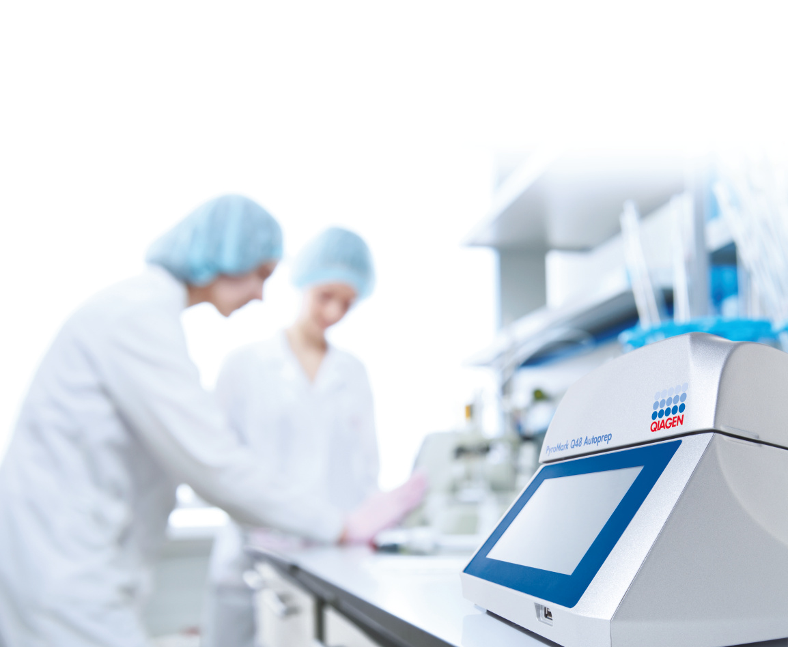
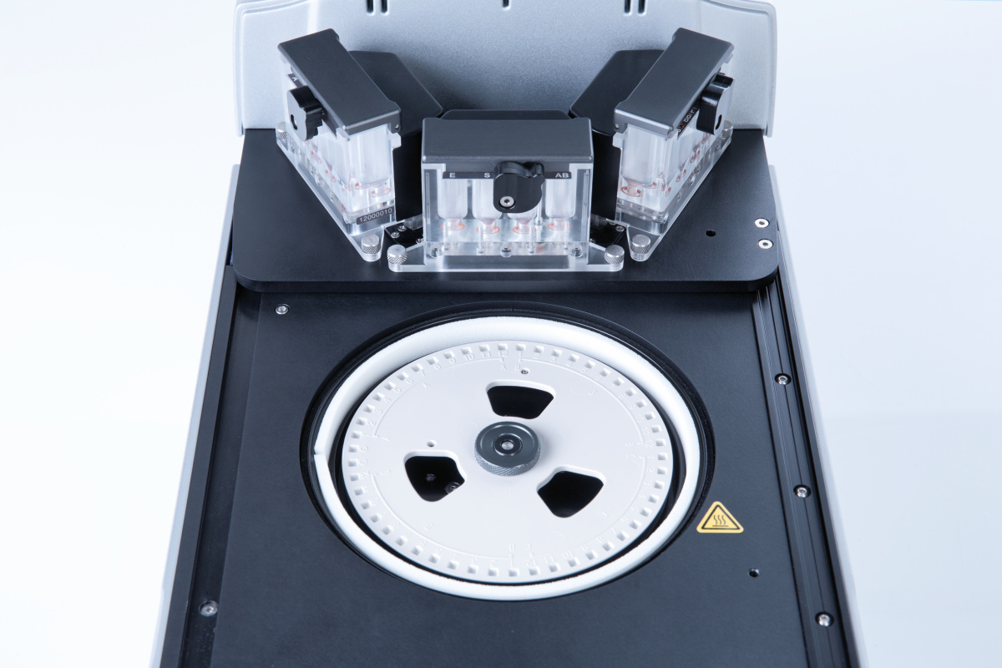
PyroMark Q48 Autoprep instrument for quantitative methylation analysis
A small benchtop instrument​
Install the Q48 Software in your PC​
Experimental set-up can be transferred via usb or network to the instrument​
Touchscreen enables you to easily operate the instrument
Load your PCR template and magnetic beads​
The instrument will dispense all other necessary reagents​
Analysis of 48 samples takes ≤ 1 h ​
Sequences will be directly reported including percentage of methylation​
Notes:
The PyroMark instrument is a small benchtop instrument (W X D X H: 250 mm (9.8 in.) X 300 mm (11.8 in.) X 300 mm (11.8 in.))
The customer receives the PyroMark Q48 Autoprep software with the instrument and can install it at any PC/laptop they use.
An experiment will be set-up in the software first by choosing the analysis method, e.g. SNP detection; methylation analysis; or sequencing and assigning sample IDs/names for the wells that will be used.
This information can be transferred to the instrument by usb stick or over their network
The instrument itself has a touchscreen to navigate through the menu.
The disc needs to be loaded manually with the beads and the PCR product (we’re working on a QIAgility alternative of this process).
Sequencing primers can be manually added to each well or dispensed by the instrument (up to 3 or max 4 different sequencing primers per disc).
Nucleotides, buffers and reagents are added to the cartridges and will be dispensed by the instrument based on the protocol loaded.
A subset of the 48 wells of a disc can be used. A well can only be used once, but the disc can be used up to 4 times, e.g. for 4 times 12 samples.
The instrument will first bind the fragments to the magnetic beads and generated ssDNA by denaturation.
The sequencing primer will be added, and the nucleotides dispensed in each well. Dispensation order is determined during experimental set-up.
Depending on the analysis method and read length the instrument will take between 45 minutes and 1,5 hours until results will be available.
No further data analysis software is required.
For methylation analysis the % of methylation will be directly displayed as a result of the run.

Slide 91
Agenda
Epigenetics, DNA methylation and cancer research
Considerations in sample preparation by bisulfite conversion
A Liquid Biopsy Compatible solution for detection of Methyl markers in NGS
Pyrosequencing – biomarker validation for clinical research
Summary

Slide 92
QIASeq Targeted Methyl Summary
QIAseq Targeted Methyl Panel: Liquid Biopsy Capable panels with a single day to sequencer from nanograms of input
Can’t get 40ng of input?
no problem go as low as 1-10ng of input to your bisulfite reaction
Pressed for time?
Library prep takes less than 7 hours, with bisulfite conversion only add another 1.5 hours before you are on the sequencer
Never run Methylation Data Analysis before?
Cloud based and local solutions on Geneglobe.com and through the QIAGEN CLC Workbench
Fully Customize your content!
Custom design up to 1000’s of targets from a single pool
Will it work with FFPE and ccfDNA?
Compatible with fresh tissue, FFPE and ccfDNA

Slide 93
Overview of QIAGEN DNA methylation analysis research solutions
Sample collection and stabilization
Sample preparation
Bisulfite treatment
Analysis
Data analysis
Cell-free DNA stabilization in blood samples
PAXgene ccfDNA Tubes
QIAamp MinElute ccfDNA Kit
QIAamp DNA FFPE Tissue Kit
GeneRead DNA FFPE Kit
QIAsymphony PAXgene Blood ccfDNA Kit
EpiTect Fast DNA Bisulfite Conversion Kits
NGS
QIAseq Methyl Library Kit
QIAseq Targeted Methyl Panel
Pyrosequencing
PyroMark CpG Assays
PyroMark PCR Kit
PCR
EpiTect MSP
EpiTect MethyLight PCR
CLC Genomics Workbench and Biomedical Genomics Analysis Plugin
Kits
EpiTect Fast FFPE Bisulfite
EpiTect Fast LyseAll Bisulfite
QIAcube Connect
QIAsymphony
QIAxpert (Quality control)
PyroMark Q48 Autoprep
Rotor-Gene Q
Instrumentation
Notes:
GeneRead DNA FFPE Kits:
dramatic, 90% reduction in artifactual C>T|G>A mutations
• Optimized lysis for the highest efficiency DNA extraction
EpiTect MSP Kit:
For highly accurate methylation-specific PCR (MSP) without optimization
Reliability in MSP, reduced false-positive results
Easy assay development and flexibility in primer design
Convenient master mix format for easy reaction setup
EpiTect MethyLight PCR Kit :
For quantitative, real-time probe-based PCR analysis of methylation status
Highly accurate TaqMan® probe-based real-time analysis
Reliable methylation quantification with MethyLight Assays
Convenient master mix format

Slide 94
Your partner across the continuum from life sciences to molecular diagnostics
Discovery
Translational research
Clinical development
Sample technologies
Assay technologies
Bioinformatics
Automation systems
Biological sample
Valuable molecular insights
Sample to Insight solutions

Slide 95
Appendix of Other Important Technologies 1. dPCR System – Hopkins IS early access already 2. Epidemiology aka Sequencing by Subtraction – New Ways!

Slide 96
QIAcuity digital PCR systems
Imaging/readout module
Fully integrated nanoplate-based dPCR instruments
QIAcuity One
QIAcuity Four
QIAcuity Eight
Priming/rolling and partitioning module
Thermocycling module

Slide 97
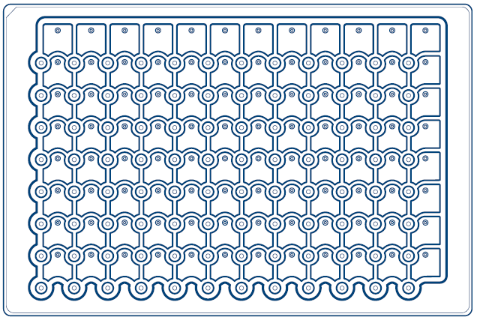
Digital PCR nanoplates
Well structure

Slide 98
Discovery Sequencing by Subtraction: rRNA removal and optimization of host-bacterial expression data

Slide 99
Humans or ‘superorganisms’?
Total number of cells: Human cells versus microbiota
Cellular composition of the ‘superorganism’
Human cells
Estimation of the number of microbial cells that live in and on the human body; human cells are outnumbered by a factor of 10
Nomenclature:
Microbiota are the microbes that live in a specific location, e.g., the human body, the gut, soil, etc.
Metagenomics is the study of the collection of genomes derived from a specific sample or community
Metatranscriptomics is the study of the RNA expression of genes from a community sample to interpret the physiological state of that community at that time
Microbiota

Slide 100
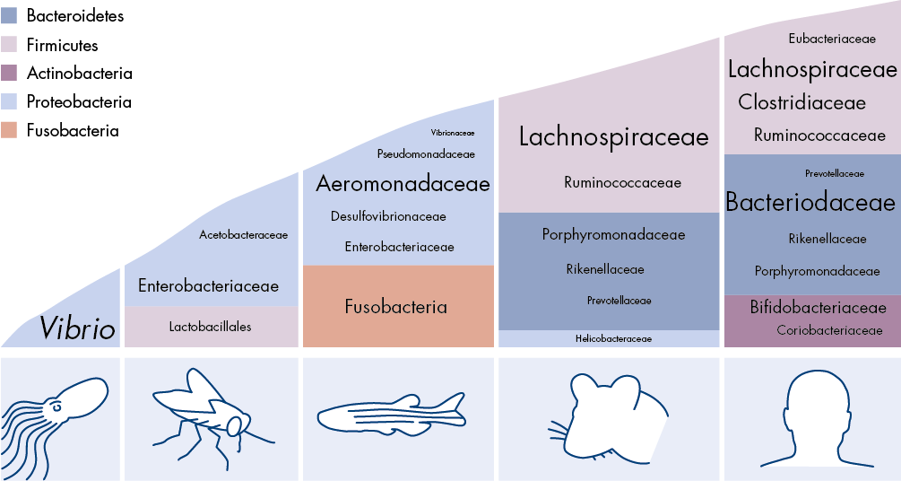
Intestinal microbiota changes throughout the course of life
Infancy Childhood Pregnancy Adulthood Old age
Infant
High inter-individual variability, low diversity
Toddler Adult-like diversity and structure
Pregnancy Increase in certain bacteria and diversity, but returns to ‘normal’ after delivery
>65 years old Numerous microbiota changes, increased Bacteroidetes
Source: Kostic, A.D., Howitt, M.R. and Garrett, W.S. (2013) Exploring host–microbiota interactions in animal models and humans. Genes Dev.27:701-718

Slide 101
Workflow for removal of both bacterial and host rRNA
Mix and match ‘FastSelects’ (you can add all three or even more)
FastSelect –5S/16S/23S: Bacterial rRNA
QIAseq FastSelect –rRNA HMR: Mammalian rRNA
QIAseq FastSelect −Globin: Mammalian Globin
Combine QIAseq FastSelect with RNA sample
Perform fragmentation (optional)
Cool stepwise from 75°C to 25°C (14 min)
Bead cleanup
Complete remaining library prep, starting with 1st strand synthesis
Coming Soon For:
Plant
Yeast

Slide 102
FastSelect –5S/16S/23S plus –rRNA HMR remove bacterial and host rRNA
FastSelect –5S/16S/23S plus –rRNA HMR robustly removes rRNA
FastSelect dramatically increases reads mapped to human + bacterial genes
Mixed samples
99% Human, 1% Gut (99H:1G)
90% Human, 10% Gut (90H:10G)
75% Human, 25% Gut (75H:25G)
50% Human, 50% Gut (50H:50G)
25% Human, 75% Gut (25H:75G)
10% Human, 90% Gut (10H:90G)
1% Human, 99% Gut (1H:99G)
FastSelect –rRNA HMR + –5S/16S/23S efficiently removes rRNA from mixed human and bacteria samples
This dramatically increases the reads mapped to human and bacterial genes (13- to 23-fold increase)

Slide 103
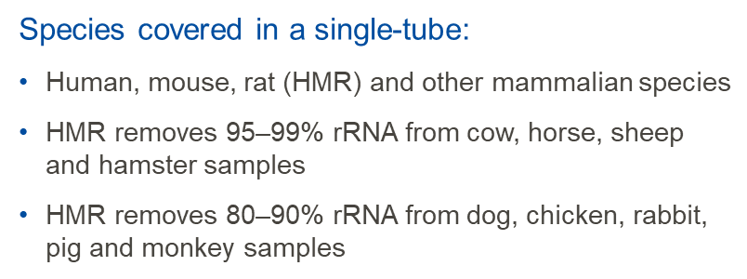
Summary
FastSelect –rRNA HMR and –Globin
FastSelect –5S/16S/23S
FastSelect –rRNA HMR plus –5S/16S/23S
1
2
3
Removes cytoplasmic and mitochondrial rRNA and/or globin mRNA by inhibiting reverse transcription of specific targets
Thirty percent faster than FastSelect V1, now in a single-tube
Covers human, mouse, rat (HMR) and other mammalian species
Compatible with several sample types, RNA types and input amounts and RNA library prep kits
Fragmentation and pan-bacterial (5S/16S/23S) rRNA depletion module which also works by inhibiting reverse transcription of specific targets
Blocks community level cDNA synthesis of 5S, 16S and 23S rRNA
Compatible with a range of RNA input amounts and most RNA library prep kits
The FastSelect –rRNA HMR plus –5S/16S/23S protocol removes both human and bacterial rRNA
One-hour protocol
Expandable to include any species
Dramatically improves sequencing read budgets by robustly removing rRNA

Slide 104
QUESTIONS?

